Slide 1
Repaso Module 4 Week 4
This week’s learning: My family and friends

Slide 2
Spanish | New starters | Module 4: Mi familia y mis amigos
1.¿Cuántas personas hay en tu familia? (How many people are there in you family?)
En mi familia hay… personas | In my family, there are… people
Mis padres | My parents
Mis abuelos | My grandparents
Mi padre | My father
Mi madre | My mother
Mi abuelo | My grandfather
Mi abuela | My grandmother
Mi hermano | My brother
Mi hermana | My sister
Mi tio | My uncle
Mi tia | My aunt
Mis primos | My cousins
4.¿Cómo es? .¿Cómo (What is he/she like?)
Es… | He/She is…
No es muy… | He/She is not very…
Alto/a | Tall
Bajo/a | Short
Delgado/a | Slim
Gordo/a | Fat
Guapo/a | Good-looking
Inteligente | Intelligent
Joven | Young
Viejo/a | Old
Tiene pecas | He/She has freckles
Tiene barba | He has a beard
7. Los números 20-100 (Numbers 20-100)
Veinte | 20
Treinta | 30
Cuarenta | 40
Cincuenta | 50
Sesenta | 60
Setenta | 70
Ochenta | 80
Noventa | 90
Cien | 100
8. Palabras muy frecuentes (High-frequency words)
Y | And
También | Also
Además | In addition
Pero | But
Sim embargo | However
Un poco | A bit
Bastante | Quite
Porque | Because
Mi/mis | My
Tu/tus | Your
Su/sus | His/her
9. Other questions
¿Cómo se llama tu (hermano)? | What is your (brother) called?
Mi (hermano) se llama… | My (brother) is called
¿Cómo se llaman tus (padres)? | What are your (parents) called?
Mis (padres) se llaman… | My (parents) are called…
2.¿Cómo tienes el pelo?/¿Cómo tiene el pelo? (What’s your hair like?)/(What’s his/her hair like?)
Tengo el pelo… | I have… hair
Tiene el pelo | He/She has… hair
Castano | Brown
Negro | Black
Rubio | Blond
Liso | Straight
Rizado | Curly
Largo | Long
Corto | Short
Soy pelirrojo | I am a redhead
5.¿Cómo es tu casa o tu piso? (What is your house or flat like?)
Vivo en… | I live in…
Una casa | A house
Un piso | A flat
Mi casa/piso es… | My house/flat is…
Antiguo/a | Old
Moderno/a | Modern
Pequeña | Small
Grande | Big
Cómodo | Comfortable
Adaptable sentences structures
1) En mi familia hay cuatro personas, mis padres, mi hermano y yo. Mi hermano se llama Jorge y tiene el pelo un poco rubio y también bastante rizado. | In my family there are four people, my parents, my brother and me. My brother is called Jorge and he has a bit blond hair and also quite curly.
2) Mi madre se llama María. Tiene el pelo largo y liso. Además tiene los ojos azules. Mi madre no es muy alta y es delgada. | .My mother is called María. She has long and straight hair. In addition, she has blue eyes. My mother is not very tall but she is slim.
3) Vivo en un piso. Mi piso es pequeño pero moderno y está en la costa | My school is modern and big. In my school there is a gym and a library, but there isn’t a swimming pool.
3.¿De qué color tienes los ojos? (What colour are your eyes?)
Tengo los ojos… | I have… eyes.
Tiene los ojos.. | He/She has… eyes.
Azules | Blue
Grises | Grey
Marrones | Brown
Llevo gafas | I wear glasses
6.¿Dónde está? (Where is it?)
Está en… | It is in…
Un pueblo | A village
Una ciudad | A city
El campo | The countryside
La costa | The coast
La montaña | The mountains

Slide 3
Task 1 Read and answer the questions
How old is Tray?
Give 3 details about his father
What relation are Violeta and Knox to him?
What are the ages of all of his grand parents?
How old are his uncle and aunt?
Give 3 details about his cousins.

Slide 4
Task 1 Read and answer the questions Answers
How old is Tray?
Give 3 details about his father
What relation are Violeta and Knox to him?
What are the ages of all of his grand parents?
How old are his uncle and aunt?
Give 3 details about his cousins.

Slide 5
Task 2 Translate 1-10 into Spanish

Slide 6
Task 2 Translate 1-10 into Spanish answers
mi madre
mi padre
mi tío
mis primos
mi abuelo
mi abuela
mi tía
mi bisabuela
mi prima
mis padres

Slide 7
Task 3 – Fill in the gaps

Slide 8
Task 3 – Fill in the gaps Answers
veinte twenty
treinta thirty
cuarenta forty
cincuenta fifty
sesenta sixty
setenta seventy
ochenta eighty
noventa one hundred

Slide 9
Task 4 Fill out the grid in Spanish with name- relation-age
Paco | abuelo | Setenta y siete

Slide 10
Task 4 Fill out the grid in Spanish with name- relation-age Answers
Paco | abuelo | setenta y siete
Beatriz | madre | cuarenta y seis
Elena | hermana | veinte
Tomás | hermano | diecisiete
Ramón | hermano | dieciséis
Victor | padre | cincuenta
Juana | madre | cuarenta y seis
Silvia | tía | cuarenta y tres

Slide 11
Task 5 Write out their hair types a-j

Slide 12
Task 5 Write out their hair types a-j answers
a. I have black hair

Slide 13
Task 5 Write out their hair types a-j answers
I have black hair
I have blonde hair
I have light brown hair
I have blue hair
I am a redhead
I have straight hair
I have curly hair
I have long hair
I have short hair
I am bald

Slide 14
Task 6 – Copy out the two verbs

Slide 15
Task 7 Translate the descriptions of Rafael, Emiliano and Angelina

Slide 16
Task 7 Answers Translate the descriptions of Rafael, Emiliano and Angelina
Emiliano. 20 yrs old.Black hair, glasses, fun, plays
guitar. is cool
b. Angelina 21 yrs old. Blonde hair, grey eyes.
Very interesting girl. Plays the drums
c. Rafael, 29 years old. Blond, straight hair. Green eyes.
Intelligent, kind and very handsome. Plays in a group
called Supergenial. He is fab

Slide 17
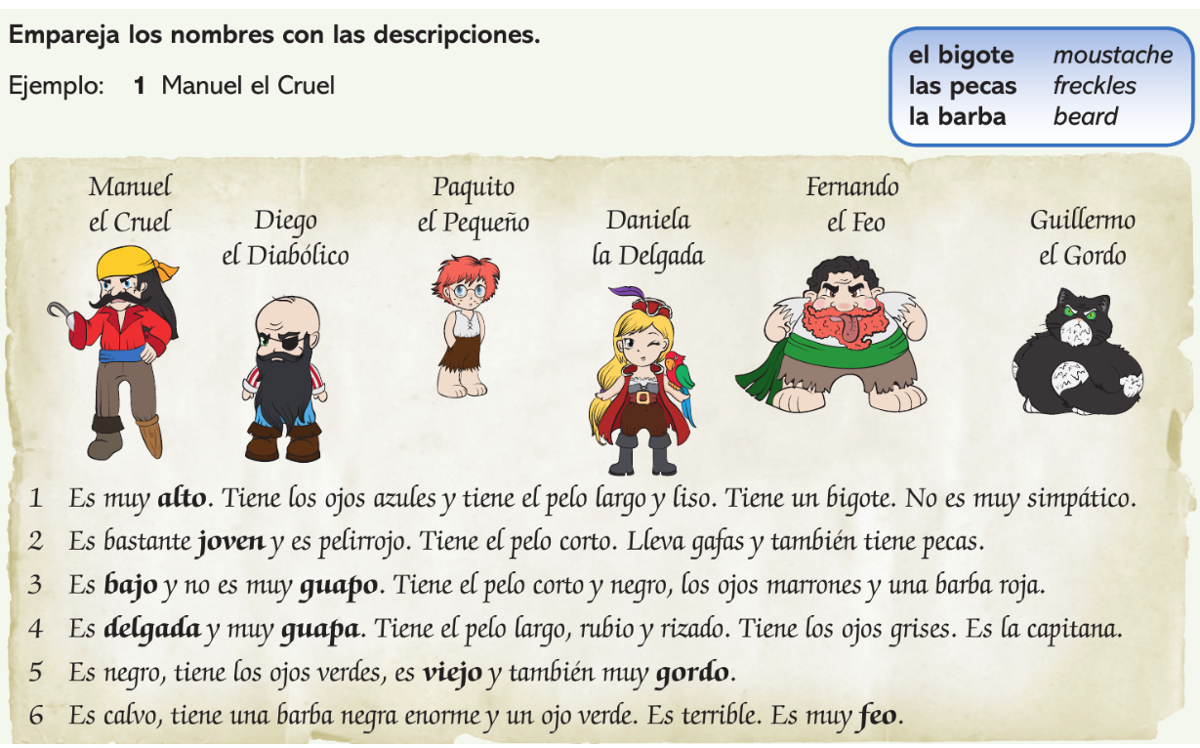
Task 8 Match the name with sentences 1-6

Slide 18
Task 8 Match the name with sentences 1-6 Answers
Manuel el cruel
Paquito el pequeño
Fernando el feo
Daniela la delgada
Guillermo el gordo
Diego el diabólico

Slide 19
Task 9 Read the text again and find the phrases 1-6 below

Slide 20
Task 9 Read the text again and find the phrases 1-6 below answers
Es muy alto
es bastante joven
es bajo y no es muy guapo
es delgada y muy guapa
es Viejo y también muy gordo
es muy feo

Slide 21
Task 10 Read the text ad answer 1-6 with a name

Slide 22
Task 10 Read the text ad answer 1-6 with a name Answers
Ray
Elizabeth Velez
Roberto
Rudy
Rony
Reyna

Slide 23
Task 11 Read the descriptions of the houses and do the activity
1.Which house is in the country?
2. Which is a comfortable flat?
3. Which is an old house?
4. Which house is in the desert?
5. Which is pretty?
6. Which is modern?
7. Which is in town?
8. Which is in a village?
9. Which is big?
10 Which is on the coast?

Slide 24
Task 11 Read the decriptions of the houses and do the activity Answers
1.Which house is in the country?- e
2. Which is a comfortable flat?- c
3. Which is an old house? –b
4. Which house is in the desert? – f
5. Which is pretty?-a
6. Which is modern? – f
7. Which is in town?- c
8. Which is in a village?- b
9. Which is big?- e
10 Which is on the coast? d

Slide 25
Task 12 Read the text and fill the gaps 1-6

Slide 26
Task 12 Answers
casa grande
muy cómoda
familia
en la costa de Cádiz
antigua
un poco aburrido

