Slide 1
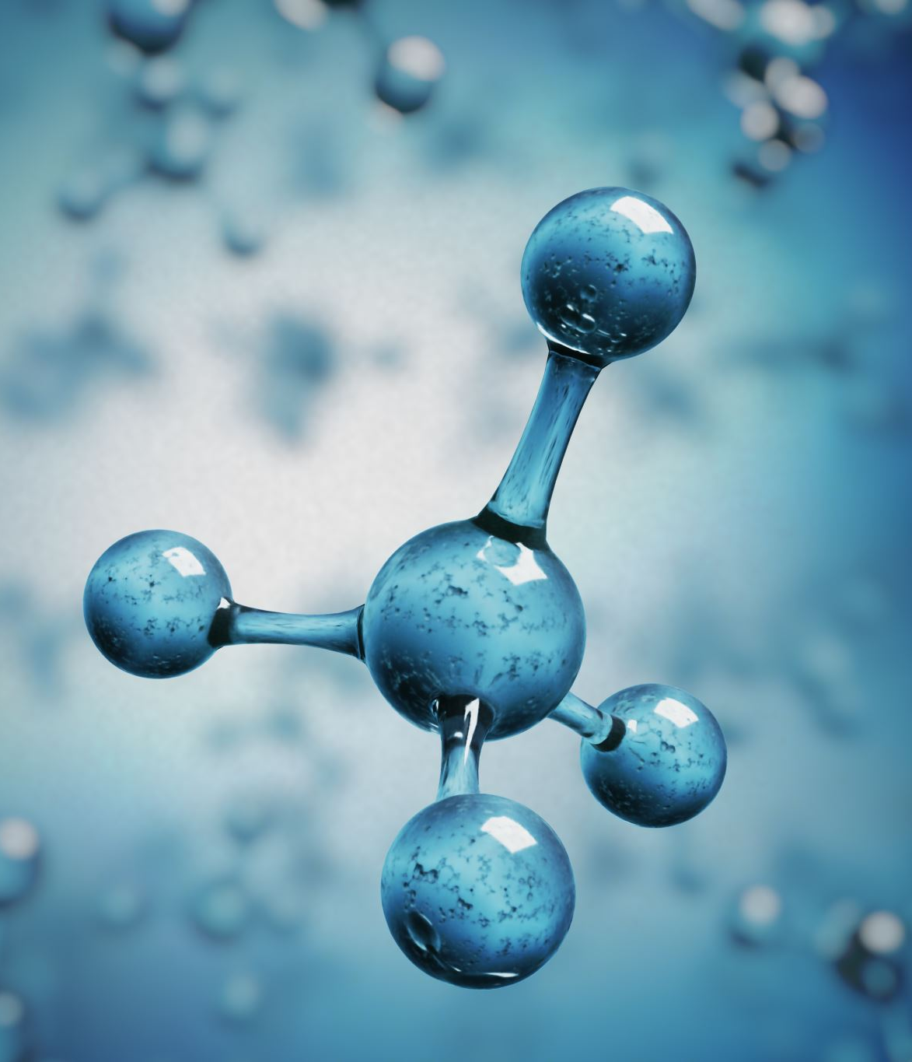
A Level Chemistry at Thomas Deacon Academy
Project 1

Slide 2
Welcome to the Chemistry Department
This Chemistry Transition Booklet contains information to support your transition from GCSE to A Level study..*
As well as this welcome page, the folder also contains the following documents:
Course overview
Key skills required for the course
Useful resources to help you reach the required knowledge
GCSE knowledge check questions
Wider reading and learning
Chemistry related career and University degree options
The booklet is intended to help you to learn more about the subject and give you an idea of where you can find out more about studying it at A Level. It should also clarify in your mind the reasons why you want to study chemistry, or whether you want to study it at all.
You should download the specification, which can be found below:
https://www.ocr.org.uk/Images/171720-specification-accredited-a-level-gce-chemistry-a-h432.pdf
If you wish to print this, pages 12-69 cover the syllabus content.
* Students should note that completion of this booklet does NOT guarantee a place on the A level Chemistry course.
We think there is color, we think there is sweet, we think there is bitter, but in reality there are atoms and a void.
DEMOCRITUS, C. 460 – C. 370 BC

Slide 3
Contents
Course overview
What modules and topics are covered
Is this course for me?
What to expect
Key skills for A level Chemistry
Useful resources and websites
Key skills practice questions
Feedback from teacher
Wider reading
Why is Chemistry important in life anyway? Why should I care?
Where can Chemistry take me in life?
Wider learning opportunities

Slide 4
1. Course Overview
A summary of the content for the A level course is as follows:

Slide 5
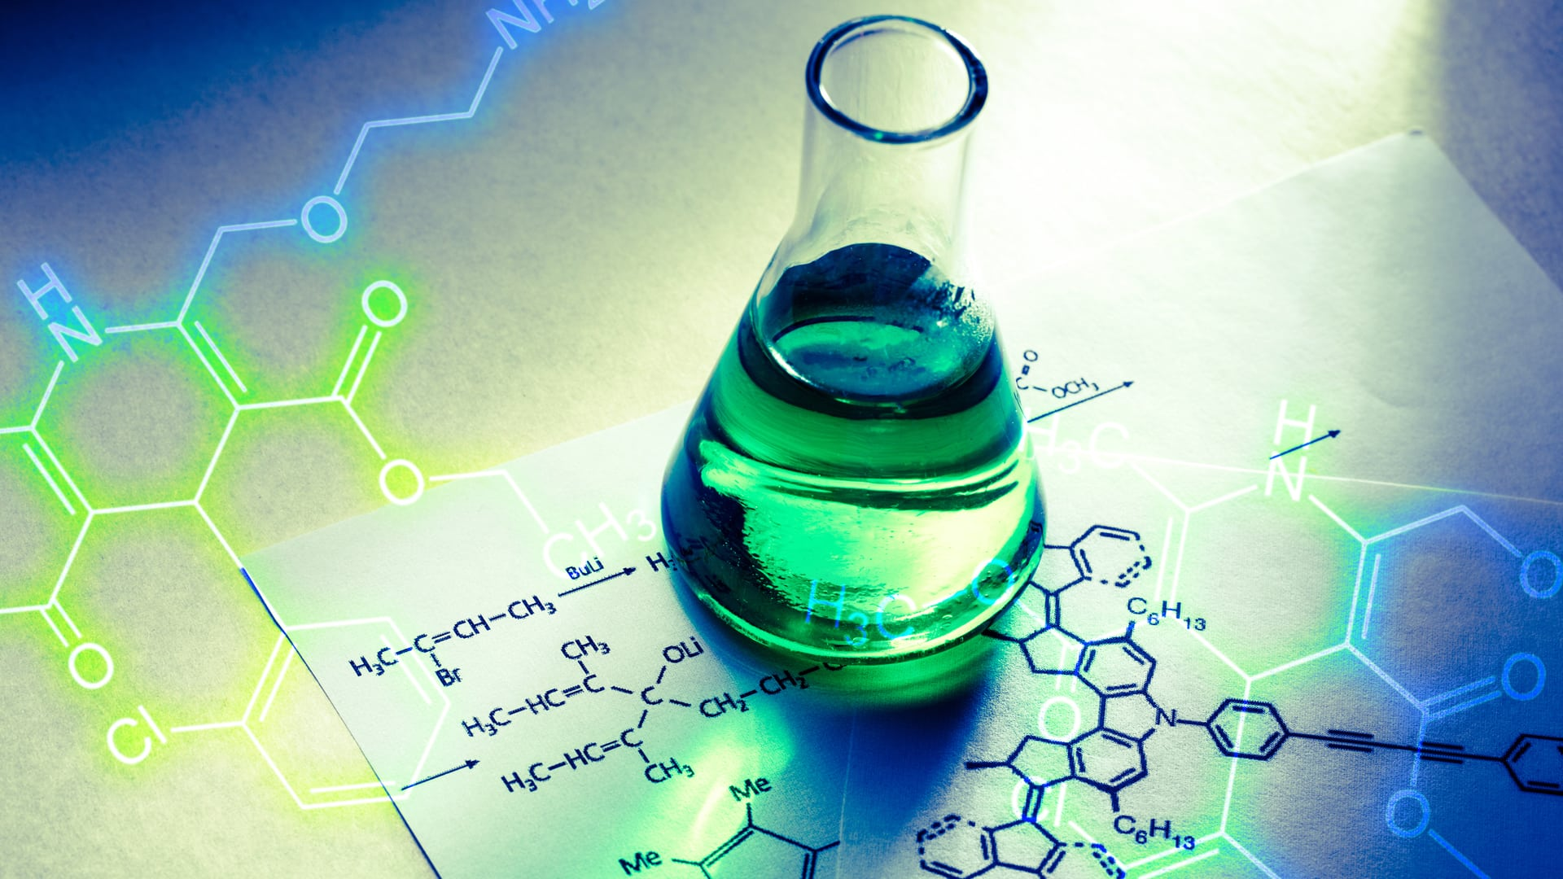
1. Course Overview
The first four modules comprise the AS Level in Chemistry A course
Learners studying the A Level continue with the content of modules 5 and 6.
The internally assessed Practical Endorsement skills also form part of the full A level
Year 1 content:
Module 1 – Development of practical skills in chemistry
Practical skills assessed in a written examination
Practical skills assessed in the practical endorsement
Module 2 – Foundations in chemistry
Atoms, compounds, molecules and equations
Amount of substance
Acid–base and redox reactions
Electrons, bonding and structure
Module 3 – Periodic table and energy
The periodic table and periodicity
Group 2 and the halogens
Qualitative analysis
Enthalpy changes
Reaction rates and equilibrium (qualitative)
Module 4 – Core organic chemistry
Basic concepts
Hydrocarbons
Alcohols and haloalkanes
Organic synthesis
Analytical techniques (IR and MS)
Year 2 content:
Module 5 – Physical chemistry and transition elements
Reaction rates and equilibrium (quantitative)
pH and buffers
Enthalpy, entropy and free energy
Redox and electrode potentials
Transition elements
Module 6 – Organic chemistry and analysis
Aromatic compounds
Carbonyl compounds
Carboxylic acids and esters
Nitrogen compounds
Polymers
Organic synthesis
Chromatography and spectroscopy (NMR)

Slide 6
1. Is this course for me?
Have you got what it takes?
Chemistry is a demanding A level course. You will be expected to work independently outside of the classroom. The emphasis is on you: your teacher will provide you with the theory, but you will need to use your study periods to practice, make additional notes and continually revise and refresh previous topics through the course.
You will need to be resilient, hard working and driven to succeed in A level Chemistry
What is expected from you
Prepared to learn, with equipment: pens, folder, calculator etc.
Prompt and present: turn up, on time, ready to learn
Use own time to recap and review topics throughout the duration of the course
Smile on your face (because it’s the best subject ever!!)
Key questions to ask yourself
Are you the type of student to seek extra work from your teacher?
Do you complete and submit work to a deadline?
Do you work independently, without someone constantly nagging you?
Do you complete all tasks to the best of your ability?
Do you carry on going even when the work gets really challenging?
Do you seek help when you are struggling?
If the answers to these questions are yes, then you sound like someone that has the potential to succeed on an A level Chemistry course

Slide 7
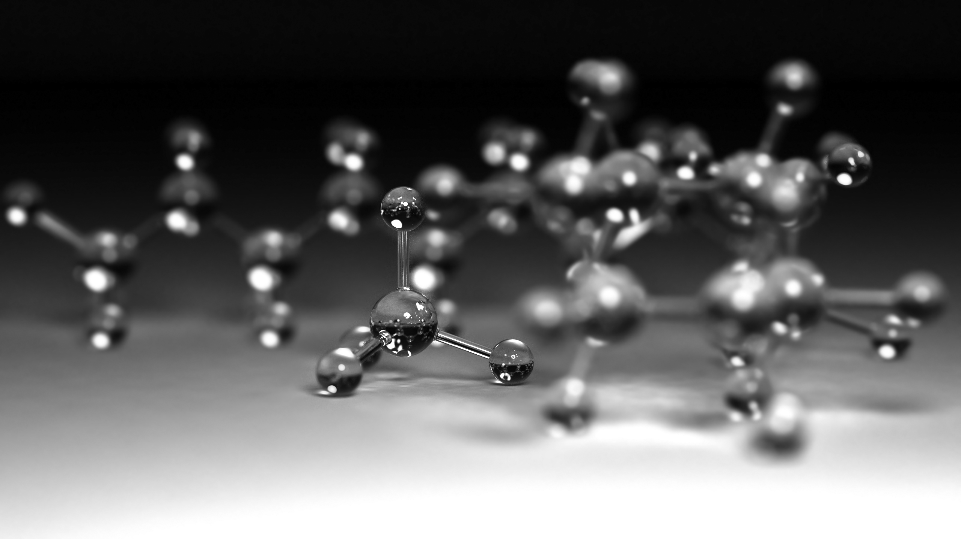
2. Key skills
Skills you must be able to show at the beginning of the course:
Define practical science key terms
Balance equations
Recall basic chemical formula and charges on ions
Use the charges on ions to deduce unknown chemical formulae
Identify the type of bonding in common substances
Rearrange equations
Calculate moles
Calculate Mr values
Calculate percentage yield and percentage error
Interpret graphs of reactions
Explain how a variety of factors can change the rate of a reaction
Recall the names and formulae of basic alkane and alkenes

Slide 8
3. Useful resources and websites
Useful resources and websites to brush up on the required skills and ensure you fully understand the GCSE syllabus:
Basic Atomic Structure: https://www.chemguide.co.uk/atoms/properties/gcse.html#top
Basic Kinetic theory: https://www.chemguide.co.uk/physical/kt/basic.html#top
Basic chemical energetics:https://www.chemguide.co.uk/physical/energetics/basic.html#top
Chemical calculations: https://www.bbc.co.uk/bitesize/guides/zgcyw6f/revision/1
https://www.bbc.co.uk/bitesize/guides/z3kg2nb/revision/1
Chemical synthesis: https://www.bbc.co.uk/bitesize/guides/zg6bmsg/revision/1
https://www.bbc.co.uk/bitesize/guides/zy3xcj6/revision/1
https://pubs.rsc.org/en/Journals?key=Title&value=Current
Course textbook
On starting the A level course you will be given a copy of the OCR A Level Chemistry textbook on loan from the school library.
Additional activities:
Visit the Royal Society of Chemistry http://www.rsc.org/
Have a look at the student pages and register with ChemNet
Find and bookmark the ‘LearnChemistry’ site

Slide 9
3. Useful resources and websites
Index notation:
In GCSE it is acceptable to give units in this form: m/s
However A-level uses index notation so:
m/s becomes m s⁻¹ and m/s² becomes m s⁻²
A space is left between different units but no space between a prefix and units.
Standard form
In science, very large and very small numbers are usually written in standard form. Standard form is writing a number in the format A × 10^{x} where A is a number from 1 to 10 and x is the number of places you move the decimal place.
For example, to express a large number such as 50 000 mol dm⁻³ in standard form, A = 5 and x = 4 as there are four numbers after the initial 5.
Therefore, it would be written as 5×10⁴ mol dm⁻³.
To give a small number such as 0.000 02 Nm² in standard form, A = 2 and there are five numbers before it so x = −5.
So it is written as 2×10⁻⁵ Nm².
Significant figures:
All non-zero numbers ARE significant
Zeros between two non-zero digits ARE significant.
Leading zeros are NOT significant. They're nothing more than "place holders.”
Trailing zeros when a decimal is shown ARE significant.
Trailing zeros in a whole number with no decimal shown are NOT significant.

Slide 10
4. Key skills practice questions
Standard form and significant figures:
Answer the following questions:
1. Change the following values to standard form.
a boiling point of sodium chloride: 1413 °C
b largest nanoparticles: 0.0 001×10⁻³ m
c number of atoms in 1 mol of water: 1806×10²¹
2. Change the following values to ordinary numbers.
a 5.5×10⁻⁶ b 2.9×10² c 1.115×10⁴ d 1.412×10⁻³ e 7.2×10¹
3. Give the following values in the stated number of significant figures (s.f.).
a 36.937 (3 s.f.) b 258 (2 s.f.) c 0.043 19 (2 s.f.) d 7 999 032 (1 s.f.)
4. Use the equation below to calculate the number of molecules in 0.5 moles of oxygen. Write your answer in standard form to 3 s.f.
number of molecules = number of moles × 6.02 × 10²³ molecules per mole
5. Give the following values in the stated number of decimal places (d.p.).
a 4.763 (1 d.p.) b 0.543 (2 d.p.) c 1.005 (2 d.p.) d 1.9996 (3 d.p.)

Slide 11
4. Key skills practice questions
Define the following practical science key terms:
You need to be confident about the definitions of terms that describe measurements and results in A Level Chemistry.
Learn the answers to the questions below then cover the answers column with a piece of paper and write as many answers as you can. Check and repeat.
When is a measurement valid? | when it measures what it is supposed to be measuring
When is a result accurate? | when it is close to the true value
What are precise results? | when repeat measurements are consistent/agree closely with each other
What is repeatability? | how precise repeated measurements are when they are taken by the same person, using the same equipment, under the same conditions
What is reproducibility? | how precise repeated measurements are when they are taken by different people, using different equipment
What is the uncertainty of a measurement? | the interval within which the true value is expected to lie
Define measurement error | the difference between a measured value and the true value
What type of error is caused by results varying around the true value in an unpredictable way? | random error
What is a systematic error? | a consistent difference between the measured values and true values
What does zero error mean? | a measuring instrument gives a false reading when the true value should be zero
Which variable is changed or selected by the investigator? | independent variable
What is a dependent variable? | a variable that is measured every time the independent variable is changed
Define a fair test | a test in which only the independent variable is allowed to affect the dependent variable
What are control variables? | variables that should be kept constant to avoid them affecting the dependent variable

Slide 12
4. Key skills practice questions
Define the following practical science key terms:
Now you have practiced, complete the definitions below without looking at the previous page:
When is a measurement valid?
When is a result accurate?
What are precise results?
What is repeatability?
What is reproducibility?
What is the uncertainty of a measurement?
Define measurement error
What type of error is caused by results varying around the true value in an unpredictable way?
What is a systematic error?
What does zero error mean?
Which variable is changed or selected by the investigator?
What is a dependent variable?
Define a fair test
What are control variables?

Slide 13
4. Key skills practice questions
Recall basic chemical formula and charges on ions:
Answer the questions below:
What does an atom consist of?
What are the relative masses of a proton, neutron, and electron?
What are the relative charges of a proton, neutron, and electron?
How do the number of protons and electrons differ in an atom?
How does the number of protons differ between atoms of the same element?
What force holds an atom nucleus together?
What is the proton number / atomic number of an element?
What is the mass number of an element?
What is an isotope?

Slide 14
4. Key skills practice questions
Recall basic chemical formula and charges on ions:
Answer the questions below:
What is the equation for relative isotopic mass?
What is the equation for relative atomic mass (Ar)?
What is the equation for relative molecular mass (Mr)?
What is an ion?
Define the term cation
Define the term anion
What is the function of a mass spectrometer?
What is a mass spectrum?
What is a binary compound?

Slide 15
4. Key skills practice questions
Identify the type of bonding in common substances:
Draw the dot cross diagrams for the following compounds, showing only outer electrons.
You will need to decide what type of bonding is present in these compounds before you start
Oxygen gas | Sodium chloride
Magnesium oxide | Water
Carbon dioxide | Calcium chloride
Ethane | Nitrogen gas
Ammonia | CHALLENGE: Ethanal

Slide 16
4. Key skills practice questions
Balancing equations:
1. Balance the following equations.
a C + O₂ → CO
b N₂ + H₂ → NH₃
c C₂H₄ + O₂ → H₂O + CO₂
2. Balance the equations below.
a C₆H₁₄ + O₂ → CO₂ + H₂O
b NH₂CH₂COOH + O₂ → CO₂ + H₂O + N₂
3. Balance the equations below.
a Mg(OH)₂ + HNO₃ → Mg(NO₃)₂ + H₂O
b Fe(NO₃)₂ + Na₃PO₄ → Fe₃(PO₄)₂ + NaNO₃
Rearranging equations:
1. Rearrange the equation shown to make:
a n the subject of the equation
b V the subject of the equation.
2. Rearrange the equation PV = nRT to make:
a n the subject of the equation
b T the subject of the equation.

Slide 17
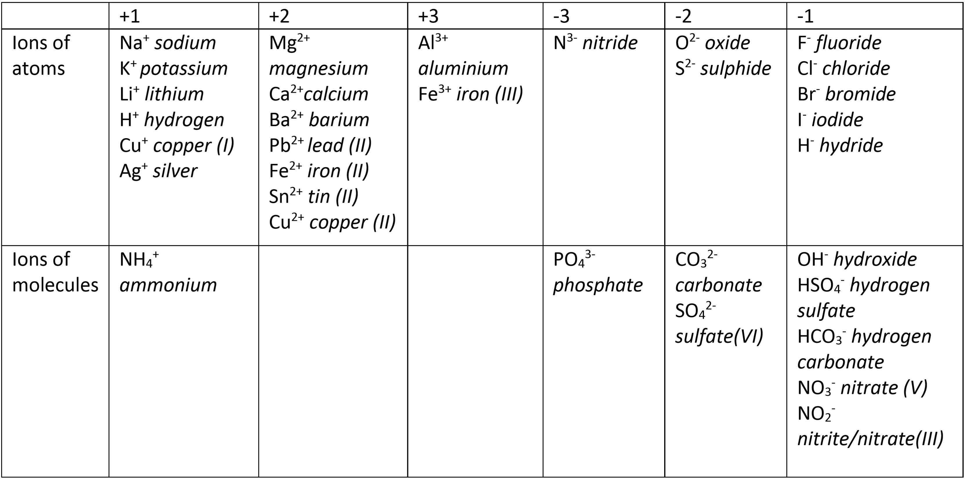
4. Key skills practice questions
Use the charges on ions to deduce unknown chemical formulae:
1. You need to be familiar with charges of common ions. Use the table above to write the chemical formula for the following:
Sodium chloride
Ammonium sulfate
Iron(II) hydroxide
Magnesium hydrogencarbonate
Copper(II) iodide
Phosphoric acid (hydrogen phosphate)
Tin(II) chloride
Potassium hydrogensulphate
Barium nitrate
Silver bromide
2. Now calculate the molar mass (Mr) for 1. a) – j). A periodic table is on the next page.

Slide 18
4. Key skills practice questions

Slide 19
4. Key skills practice questions
Converting units:
1. Calculate the following unit conversions.
a 300 µm to m
b 5 MJ to mJ
c 10 GW to kW
Calculating moles:
1. Calculate the concentration, in mol dm⁻³, of a solution formed when 0.2 moles of a solute is dissolved in 50 cm³ of solution.
2. Calculate the concentration, in mol dm⁻³, of a solution formed when 0.05 moles of a solute is dissolved in 2.0 dm³ of solution.
3. Calculate the number of moles of NaOH in an aqueous solution of 36 cm³ of 0.1 mol dm⁻³.
4. In a reaction, 0.486 g of magnesium was added to oxygen to produce magnesium oxide.
2Mg(s) + O₂(g) → 2MgO(s)
a Calculate the amount, in moles, of magnesium that reacted.
b Calculate the amount, in moles, of magnesium oxide made.
c Calculate the mass, in grams, of magnesium oxide made.

Slide 20
4. Key skills practice questions
Calculating moles continued:
5. Oscar heated 4.25 g of sodium nitrate. The equation for the decomposition of
sodium nitrate is:
2NaNO₃(s) → 2NaNO₂(s) + O₂(g)
a Calculate the amount, in moles, of sodium nitrate that reacted.
b Calculate the amount, in moles, of oxygen made.
6. 0.500 kg of magnesium carbonate decomposes on heating to form magnesium oxide and carbon dioxide. Give your answers to 3 significant figures.
MgCO₃(s) → MgO(s) + CO₂(g)
a Calculate the amount, in moles, of magnesium carbonate used.
b Calculate the amount, in moles, of carbon dioxide produced.

Slide 21
4. Key skills practice questions
Calculating percentage yield and percentage errors:
1. Calculate the percentage yield of a reaction with a theoretical yield of 4.75 moles of product and an actual yield of 3.19 moles of product. Give your answer to 3 significant figures.
2. Calculate the percentage yield of a reaction with a theoretical yield of 12.00 moles of product and an actual yield of 6.25 moles of product. Give your answer to 3 significant figures.
3. A gas syringe has a maximum error of ±0.5 cm³. Calculate the maximum percentage error when recording these values. Give your answers to 3 significant figures.
a 21.0 cm³
b 43.0 cm³
4. A thermometer has a maximum error of ±0.5 °C. Calculate the maximum percentage error when recording these temperature rises. Give your answers to 3 significant figures.
a 12.0 °C
b 37.6 °C

Slide 22
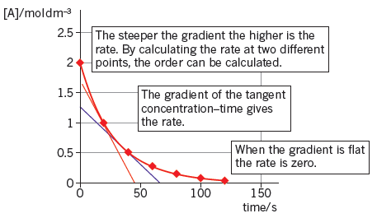
4. Key skills practice questions
Interpreting graphs of reactions:
1. Using the graph, calculate the rate of reaction when the concentration of A halves again to 0.5 mol dm−3.
2. The table below shows the change in concentration of bromine during the course of a reaction.
a Plot a concentration–time graph for the data in the table. Use the graph paper on the next page.
Time / s | [Br₂] / mol dm⁻³
0 | 0.0100
60 | 0.0090
120 | 0.0066
180 | 0.0053
240 | 0.0044
360 | 0.0028

Slide 23
4. Key skills practice questions
Interpreting graphs of reactions continued:
2.
b Calculate the rate of decrease of Br₂ concentration by drawing tangents.
c Find the half-life at two points and deduce the order of the reaction.

Slide 24
4. Key skills practice questions
Explain how a variety of factors can change the rate of a reaction:
1. Ethanol and ethanoic acid react together to form the ester ethyl ethanoate and water in an equilibrium reaction:
Write an expression for the equilibrium constant, K_{c}.
2. Nitrogen and hydrogen react together to form ammonia in an equilibrium reaction:
N₂(g) + 3H₂(g) ⇌ 2NH₃(g)
The equilibrium concentrations are: hydrogen, H₂(g) = 2.00 mol dm⁻³; nitrogen, N₂(g) = 1.20 mol dm⁻³; and ammonia, NH₃(g) = 0.876 mol dm^{−3.}
a Calculate the value of the equilibrium constant, K_{c}. The units for this equilibrium constant are mol⁻² dm⁶.
b If the pressure of the system is increased, will the value of the equilibrium constant increase or decrease? Explain your answer.
C₂H₅OH(l) | + | CH₃CO_{O}H(l) | ⇌ | CH₃CO₂C₂H₅(l) | + | H₂O(l)
ethanol |  | ethanoic acid |  | ethyl ethanoate |  | water

Slide 25
4. Key skills practice questions
Recall the names and formulae of basic alkane and alkenes:
1. Explain why alkanes are said to be hydrocarbons
2. How many bonds does a carbon atom always have?
3. State the correct molecular formula for hexane.
4. What is the general formula for an:
a alkane
b alkene
5. Name and draw the first 5 alkanes and alkenes in the tables below
.
Alkane name | Alkane structure
Alkene name | Alkene structure

Slide 26
5. Feedback from Teacher
Based on the work you have completed a summary of your strengths and areas for improvement are outlined below:
Your strengths are:
2. Your areas for improvement are:
3. STUDENT TO FILL IN FOLLOWING FEEDBACK
In order to improve my weaker areas I will set myself the following three targets. HINT: These should be specific, achievable actions to set yourself.
.
1. 2. 3. I will know when I have achieved my targets because . . .

Slide 27
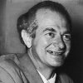
6. Why is Chemistry important to the world?
Chemistry is important to our everyday lives, it is everywhere and responsible for everything. The study of chemistry is really the study of everything since all matter is made of chemicals.
Read this article “Importance and Scope of Chemistry”: https://www.toppr.com/guides/chemistry/some-basic-concepts-of-chemistry/importance-and-scope-of-chemistry/
Watch this series of videos: https://topdocumentaryfilms.com/chemistry-almost-everything/
Every aspect of the world today – even politics and international relations – is affected by chemistry.
LINUS PAULING, 1901 TO 1994

Slide 28
6. Where can Chemistry take me in life?
Studying chemistry gives you many options for your future. It can lead to a career in industries such as manufacturing, pharmaceuticals, petrochemicals and healthcare. Specific job roles include analytical scientist, chemist, medical scientist, forensic scientist, pharmacologist and toxicologist.
Chemistry teaches you a wide variety of transferable skills allowing you to go into alternative careers including civil service, environmental consultancy, higher education lecturer, management consultancy, nuclear engineering, patent attorney, radiation protection practitioner, or science writing.
At University there are a variety of chemistry-based degrees that you can study*:
chemistry (including options to spend a year of your degree in industry)
applied chemistry
biochemistry
pharmacology
environmental science
forensic science
*The degrees offered will differ depending on the university to which you apply

Slide 29
6. Wider learning opportunities
You’ve got the Summer Holidays in front of you so why not try out some of these wider learning opportunities in your free time?
Books
The Pleasure of Finding Things Out - Richard Feynman
Periodic Tales - Hugh Aldersey-Williams
The Disappearing Spoon - Sam Kean
Uncle Tungsten - Oliver Sachs
The Shocking History of Phosphorus: A Biography of the Devil’s Element - John Emsley
Magazine/Journals
Scientific American
New Scientist
The Mole
Places of Interest
Royal Society of Chemistry - Burlington Arcade, Regents Street London
Science Museum, London
Museum of the History of Science, Oxford
Curie Museum, Paris
Websites
Periodic Table of Videos by Martyn Poliakoff http://www.periodicvideos.com/about.htm
Royal Society of Chemistry www.rsc.org.uk
Institution of Chemical Engineers www.icheme.org
www.chemguide.co.uk

