Slide 1
Introduction to Sociology

Slide 2
Welcome to Sociology
Hello year 11, I hope you are all well ☺
We are very pleased to welcome you to Sociology at Thomas Deacon Academy. You have selected a fantastic course which I am sure you will find really interesting. The sociology teachers are Miss Shabir and Mrs Younis
In this power-point we will go through;
- What sociology is and the things you will be covering over the two years
- Some questions and activities for you to complete over the next few weeks

Slide 3
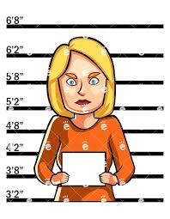
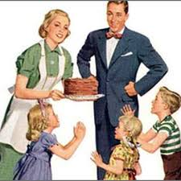
What is Sociology?
Sociology is the study of society and of people and their behaviour
Overview of the course:
This is a two-year course which ends with three two-hour papers each carrying an equal weighting towards your final A-level grade (A*-E).
Topics we will cover will include:
Year 12 Year 13
Theories of Sociology Crime and Deviance
Methods of Sociology Beliefs in Society
Families & Households Methods of Sociology
Education Theories of Sociology

Slide 4
Your tasks
You need to go through the slides and complete all of the activities. You can write or type them up.
If you have any questions please email Miss Shabir on sidra.shabir@tda.education

Slide 5
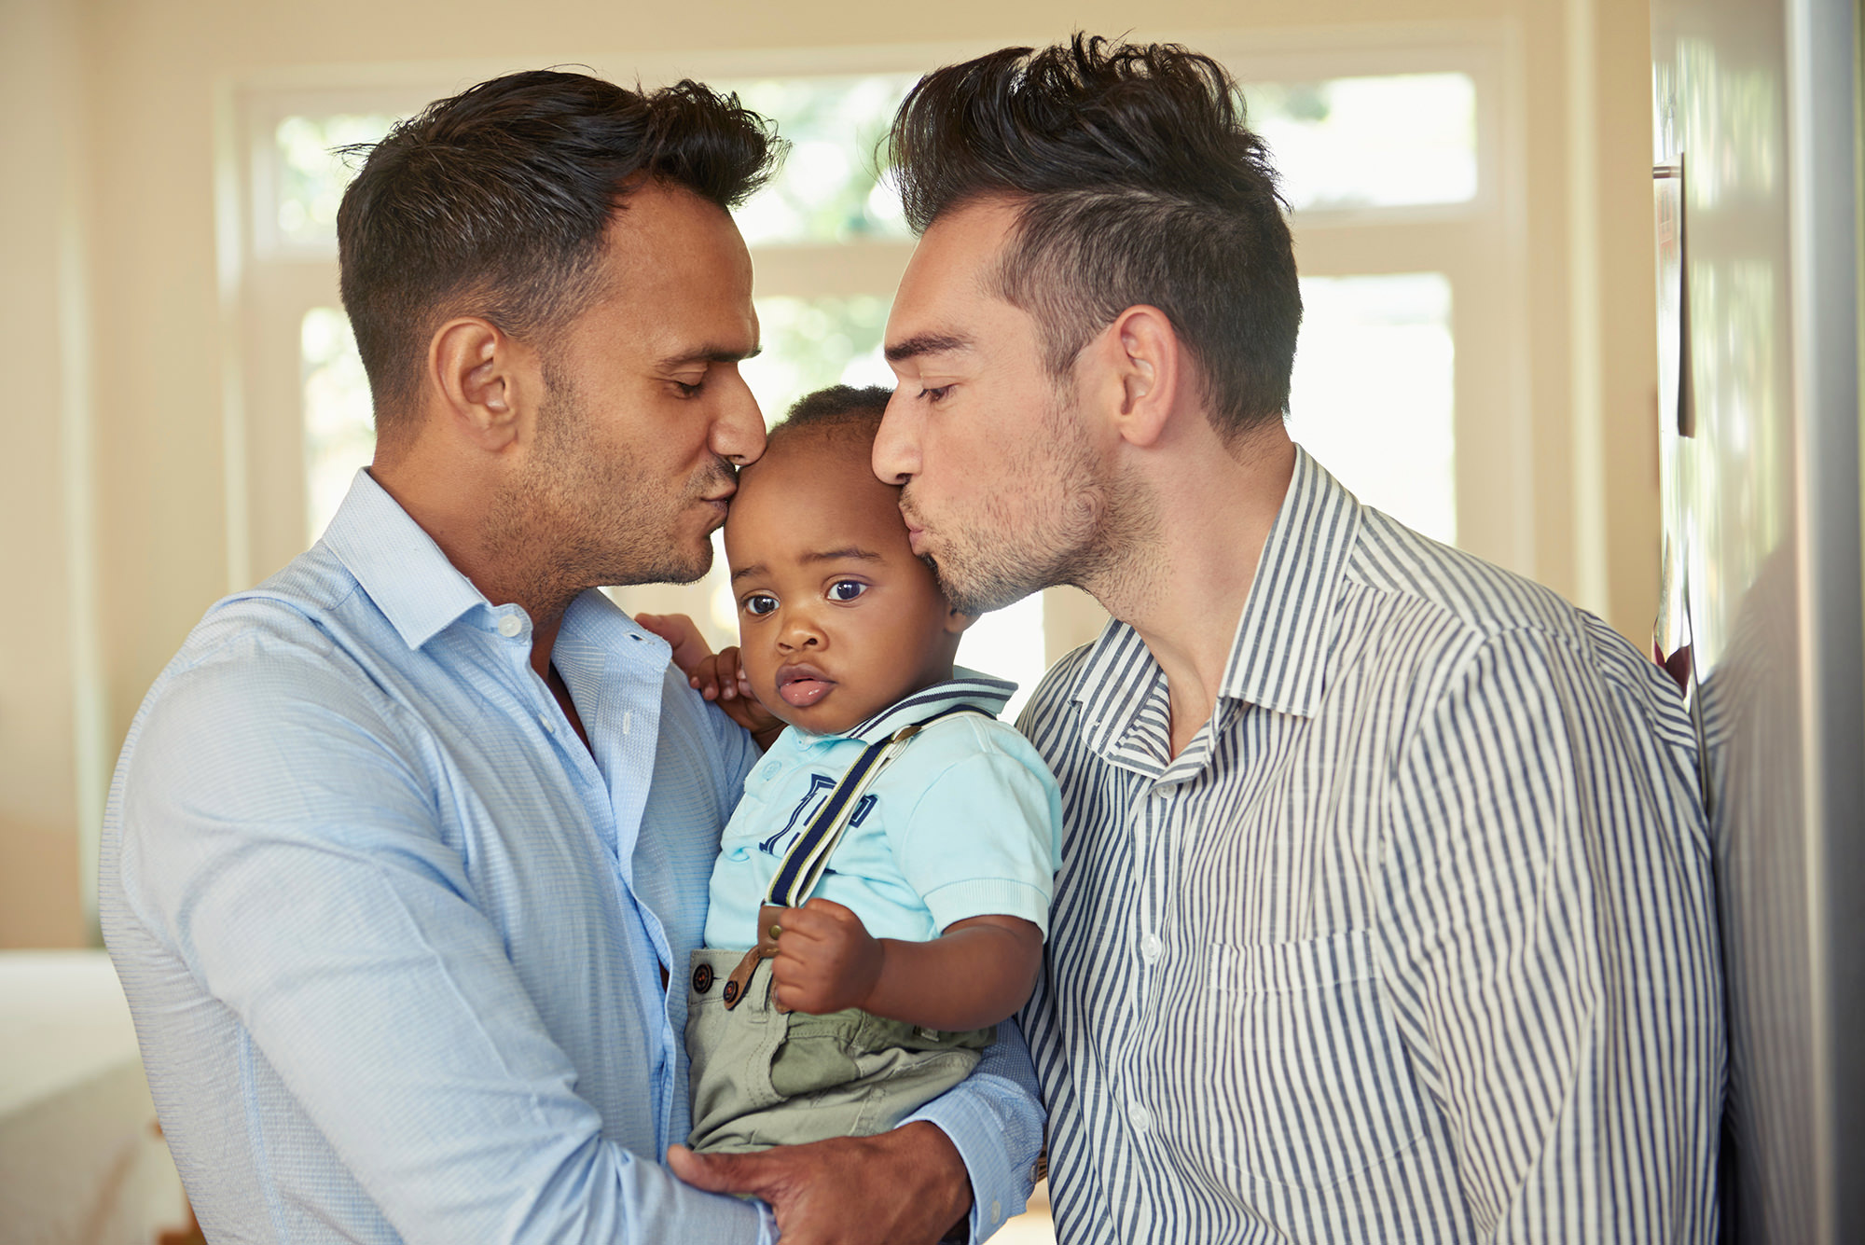
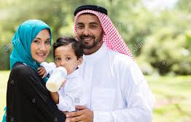
Society
The social world is changing. Some argue it is growing; others say it is shrinking. The important point to grasp is: society does not remain static over time; it constantly changes – through decades, centuries; and across countries, societies. Answer the following questions:
Give 3 different ways society has changed over the last 100yrs – think about the different areas of social life and work.
Why has society changed? Why are societies different? For example, how have schools changed? How has society change over the years?
Research the 3 main political parties – Conservative, Labour and Liberal Democrat: What are their main ideas? How are they different?
If you were in power, what would your first four items be on your agenda? What would you hope to do?
https://www.parliament.uk/about/mps-and-lords/members/parties/
http://simplepolitics.co.uk/questions-and-answers/who-are-the-parties-and-what-do-they-stand-for

Slide 6
What is sociology?
Watch the video clip on YouTube: What is Sociology? Crash Course Sociology https://www.youtube.com/watch?v=YnCJU6PaCio and make notes on what you understand about Sociology.
Find the definitions for the following key sociological terms:
Socialisation (primary socialisation and secondary socialisation)
Norms
Values
Beliefs
Culture
Social Class
Gender
Ethnicity

Slide 7
Education
Research the History of Education in the UK and answer the following questions:
When did education become compulsory in the UK?
Prior to compulsory education, what were the differences in who used to receive schooling?
What are the oldest and newest subjects?
How have the methods of dealing with behaviour changed over time?
What are some of the major changes that have taken place in UK education in the 20th and 21st centuries?
Consider the impact of the following policies:
Education Act 1944 (Tripartite System)
Comprehensives 1966
Education Reform Act 1988
Your personal view on – what is the role and purpose of education?
https://www.schoolsmith.co.uk/history-of-education/
https://getrevising.co.uk/revision-notes/social-policy-and-education

Slide 8
Family
Task 2
Research the changing family in the UK and answer the following questions:
How has the family structure changed over the past 100 years?
How have the following policies affected the family?
The Divorce Act 1969 and 1984
The Paternity Act 2010
The Civil partnerships Act 2004 and the Marriage (Same-Sex Couples) Act 2013
https://www.bbc.co.uk/bitesize/guides/zj8qn39/revision/2
https://revisesociology.com/2015/12/17/social-policy-family/
Task 1
Find the definitions for the following key family terms:
Monogamy
Bigamy
Polygamy
Maternal
Nuclear family
Empty nest
Empty shell marriage
Extended family
Kinship
Cohabitation

Slide 9
Education and family in the news
Find the definition of meritocracy.
Read the following news article https://www.tes.com/news/few-one-20-born-poorest-areas-go-university and answer the following questions:
Does this article suggest we live in a meritocracy?
Why is it important that ‘poor’ students go to university?
Find 5 news articles that link to Education and/or Families. Download and print. Some things to look out for are: immigration, poverty, benefits, exam results, private education, achievement, free schools.
https://www.independent.co.uk/topic/Sociology
https://www.theguardian.com/education/sociology

Slide 10
Sociology is everywhere: Sociology in the media
Sociology is everywhere so you’ll be able to see aspects of it in all forms of media. Try searching for the following titles and make notes on any videos you watch, try to keep it relevant to the topics taught in Sociology (Education, Families, Global Development, Crime and Deviance).
What did you learn about society?
How does the programme link to the topics you will be studying?
Stacey Dooley documentaries (BBC iplayer/YouTube)
Black Mirror (Netflix) – Nosedive episode
School Swap documentary(4OD)
Louis Theroux documentaries(Netflix)
Dispatches documentaries (40D)
Panorama documentaries (BBC iplayer)

Slide 11
Crime
Task 2
Go on the following website and research crime in your area or the area near your school. https://www.crime-statistics.co.uk/postcode/AL10%208NL and answer the following questions:
Where does most crime take place?
What are the top 3 crimes/offences?
Why do you think that those crimes are committed in your area? Think about socio-economic issues and location.
Task 1
Using the internet, research the answers to the following questions:
What is a crime?
What is deviance?
What are laws?
What is a white collar crime?
Moral crimes include offences such as prostitution, underage drinking and illegal drug use. Why do some people argue that such crimes are ‘victimless’?
What is cybercrime? Name some examples of cybercrimes.
What is a hate crime?
What do you think is more effective in reducing crime: crime prevention or harsher punishments?
https://www.coursehero.com/sg/introduction-to-sociology/defining-crime-in-sociology/

