Slide 1
An Introduction to Criminology

Slide 2
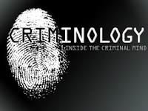
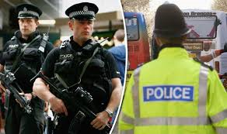
Welcome to Criminology
We are very pleased to welcome you to Criminology at Thomas Deacon Academy. You have chosen a great course which I am sure you will find really interesting.
The criminology teacher is Miss Shabir and in this presentation you will find:
Information about the course and exam board
An explanation of what criminology is
Some questions and activities for you to do over the next few weeks
Some wider reading and exploration of Criminology

Slide 3
The Criminology Course
Criminology is an applied or vocational course. You will have to refer your knowledge to real life crimes and workplace settings like courtrooms or crime scenes.
The course is 50% controlled assessment and 50% exam based.
The first year you will complete the certificate. This includes:
Unit One – Changing Awareness of Crime (controlled assessment)
Unit Two – Theories of Crime (examination)
In the second year you will complete the diploma. This includes:
Unit Three – Crime Scene to Courtroom (controlled assessment)
Unit Four – Crime and Punishment (examination)
Both of the controlled assessments are carried out over 8 hours and you will be allowed to take notes in.
If you would like to know more about the qualifications then follow the link below:
https://www.eduqas.co.uk/qualifications/criminology-level-3/#tab_overview

Slide 4
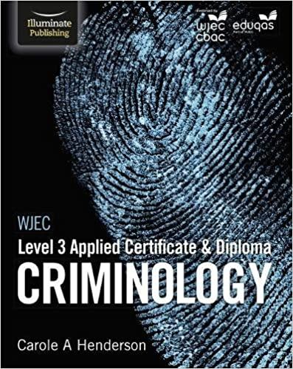
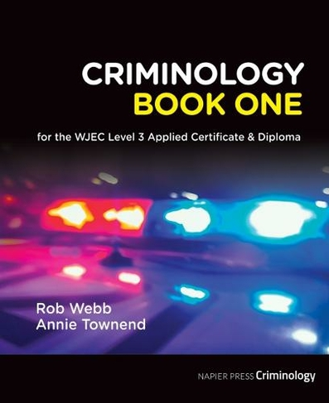
Resources and books for the course
Criminology is a subject which is at the very heart of our society and culture. Many documentaries, films and other media types are linked with criminology. As criminologists though we need to have evidence and knowledge which is gathered from research.
These are the books that we use in class. You are not provided with one because we like you to use a range of resources. A new textbook is coming out soon so I would wait until September if you want to purchase one.
This is a link to a really good website which provides some great resources for the course
https://criminology.uk.net/

Slide 5
What is Criminology?
Criminology is simply the study of crime. It looks at who commits crime, why do these people commit crime, what punishments are effective and how and why laws are made?
Watch this video to find out more.
Criminology began with the work of the Italian criminologists Cesare Lombroso.
Lombroso believed that you criminals had particular facial features and were not as fully evolved as other non criminal human beings.
Watch this video to find out more about Lombroso
This video makes interesting points about how we should always question current ideas.

Slide 6
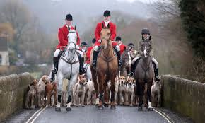
Introduction to Criminology
In this section you are going to do some interesting tasks which you will need to hand in, information about how to do this can be found at the end of the PowerPoint.
Unit one work – Changing Awareness of Crime
Crime and the laws change all the time, many changes occur as a result of individuals or organisations campaigning to change these laws. You should research one of these campaigns and explain why it was started, what was it trying to achieve and what sort of campaign methods they used (media, petitions, letters to MPs etc). Write over 200 words which explains one of these campaigns.
Sarah’s Law
The Double Jeopardy Law
Dignity in Dying
Snowdrop Campaign
Slow Down for Bobby
Anti-Foxhunting Campaign

Slide 7
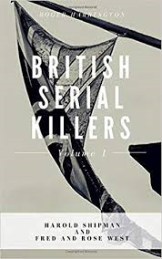
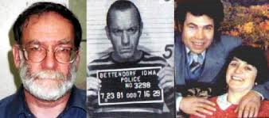
Introduction to Criminology
Unit two work – Theories of Crime
Some explanations of why people are criminal comes a nature perspective, these people believe that it is a result of genetics or people’s nature. Others believe that people are criminal because of their social position and upbringing, this is a nurture argument.
Whilst the nature nurture debate is still discussed, it is recognised that both of these arguments have some strengths in explaining some crimes but criminal behaviour is very complicated and explanations are multi-faceted.
Research the childhood backgrounds of any notorious serial murderers such as Fred West or Harold Shipman. The focus should be on life history and not subsequent crimes. Thinking about what you have read about Nature and Nurture, which explanation could account for their criminal behaviour?

Slide 8
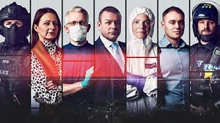
Documentaries and podcasts
When you start studying criminology you will find that interesting news articles, documentaries and podcasts all the time!
Podcasts
Shreds is a podcast about one of Britain’s most famous miscarriages of justice. It changed the way in which interviews were carried out in the UK.
https://www.bbc.co.uk/programmes/p071cll5
The Criminal Mind this is a podcast which explores the brain and its dysfunction and what we understand about ‘mindless’ violence.
https://www.bbc.co.uk/programmes/b00j6lh9
Netflix shows
When they see us – this is a drama based on the real life story of 5 boys accused of raping a woman in Central Park, New York.
The Investigator, A British Crime Story – this looks at a number of unsolved crimes.
iPlayer Shows
24/7 Murder follows a murder investigation every moment as it unfolds. A very interesting look at how crimes are investigated.
https://www.bbc.co.uk/iplayer/episode/m000frh7/murder-247-series-1-episode-1
Life and Death Row is a documentary about prisoners awaiting execution in the USA.
https://www.bbc.co.uk/iplayer/episode/b03ytvjz/life-and-death-row-series-1-1-execution

Slide 9
Tasks
Complete the unit one task
Complete the unit two task
Watch and listen to as many of the podcasts or documentaries as you can. Pick one of them and write a 200 word review of it, what is it about, did you find it interesting, what does it tell us about Criminology?
When you have completed this send it to Miss Shabir on sidra.shabir@tda.education
I hope you enjoy these activities, if you have any questions then please get in touch.

