Slide 1
War of the Worlds
This is our sixth week of studying HG Wells’ great sci-fi novel War of the Worlds. We are back to five days this week so there will be a separate writing task.
Just recapping last week chapters:
The aliens/Martians have now begun to rampage across the countryside. They are burning everyone and everything that they come across. The narrator is watching this unfold from his home with an army man who has managed to escape to the relative safety of the narrator’s home.
Titans are powerful, immortal giants from Greek mythology.
Chapter 11 continues the story so read on and enjoy. (3 slides)
Remember the times in which the story was written and set:
Please also remember this is an hour's work so take your time to read the text and questions carefully and answer in full sentences.
You do not need to understand every word and every last action – just try and make sure you have a good and clear overall understanding of who people are, where they are and what is happening.

Slide 2
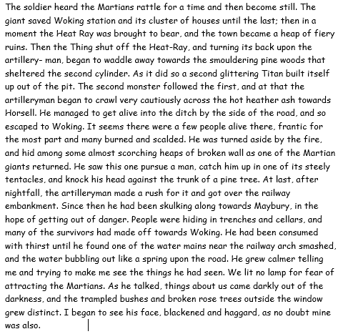
Questions: all on this slide and in chronological order
What did the giant save till last.
2) What came out of the pit?
3) What did one of the artillery man see one of the Martian giants on seeing a man?
4) Where were people hiding in order to keep themselves safe?
5) Why didn’t they light a lamp?

Slide 3
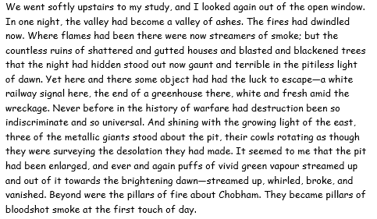
Questions: all on this slide and in chronological order
6)As the narrator looked out of his study window, describe in detail, what he saw? (3 marks)
7) How many giants stood about the pit?
8) What colour was the vapour from the pit and what colour was the smoke coming from the pillars of fire?
9) Where does the artilleryman propose to go?
10) Where was the narrator heading in the first instance and then with his wife where was he going to go?

Slide 4
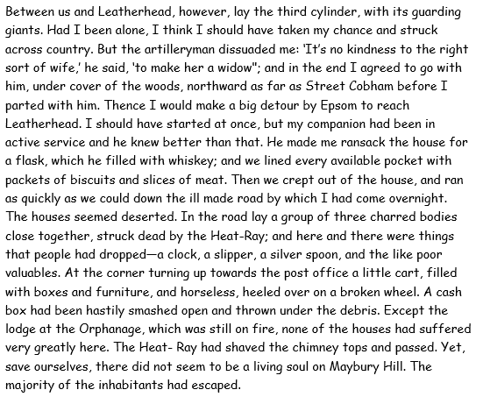
Questions: all on this slide and in chronological order
11) What was making the narrator hesitate before setting off to Leatherhead?
12) Where did the narrator and the artilleryman set off for before they would part?
13) What did they take with them on their journey?
14) What were the things that people had dropped whilst trying to escape?
15) What had happened to the people of Maybury Hill and how do you think the village would have felt to the narrator?

