Slide 1
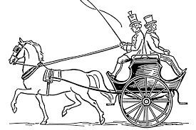
War of the Worlds
Day 4 and the last day this week of studying HG Wells’ great sci-fi novel War of the Worlds.
Chapter 9 The Fighting Begins continues and we begin Chapter 10 The Storm so read on and enjoy. (3 slides)
Some useful definitions: slide 1 hussars are cavalry soldiers – usually on horseback
horse and dog cart
palings - a fence
Please also remember this is an hour's work so take your time to read the text and questions carefully and answer in full sentences.
You do not need to understand every word and every last action – just try and make sure you have a good and clear overall understanding of who people are, where they are and what is happening.

Slide 2
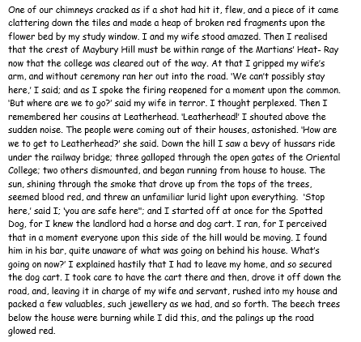
Questions: all on this slide and in chronological order
Where and how did the broken chimney end up?
2) Where was now in range of the Martians Heat-Ray as a result of the college being destroyed?
3) What does the appearance of the sun seem like?
4) Do you think if the landlord, from whom the narrator borrowed the cart, was aware of what was going on he still would have loaned it to him? Give reasons for your answer.
5) What did the narrator pack to take on his journey?

Slide 3
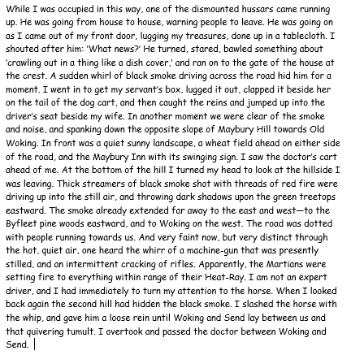
Questions: all on this slide and in chronological order
6) What news did the hussar have?
7) What obscured the hussar for a moment?
8) What was in front of the narrator as they started their journey to Leatherhead?
9) What two sounds could be heard as they continued their journey?
10) What clues are there to tell us the narrator was in a hurry?

Slide 4
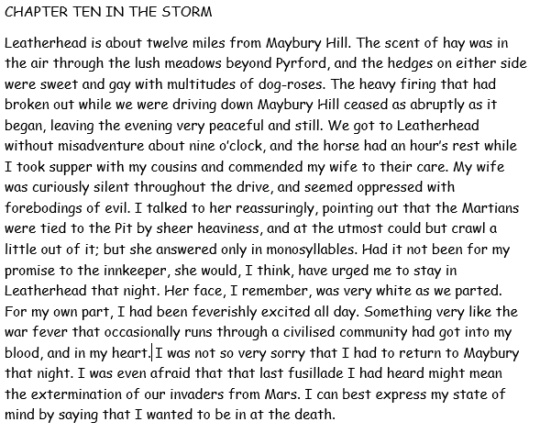
Questions: all on this slide and in chronological order
11) How does the author create a contrasting atmosphere?
12) What time did they get to Leatherhead.
13) How did his wife seem on the journey: explain in your own words?
14) Why did the narrator have to return to Maybury that night?
15) Why did the narrator not mind returning to Maybury that night?

