Slide 1
LO: To be able to design a Viking or Anglo-Saxon Brooch

Slide 2
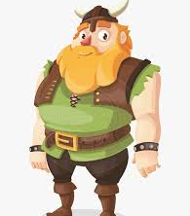
Vikings didn't have zips or buttons.
Their clothes were tied, hooked or pinned in place.

Slide 3
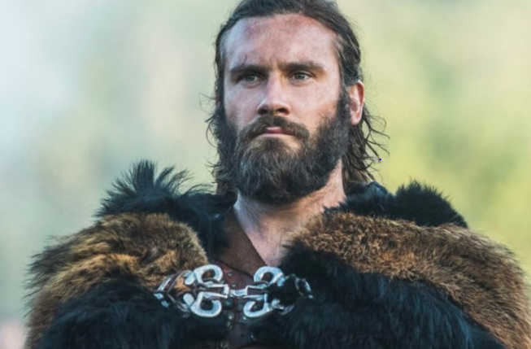
Heavy capes and cloaks used brooches to pin them in place.
If you were wealthy, you used decorative brooches.

Slide 4
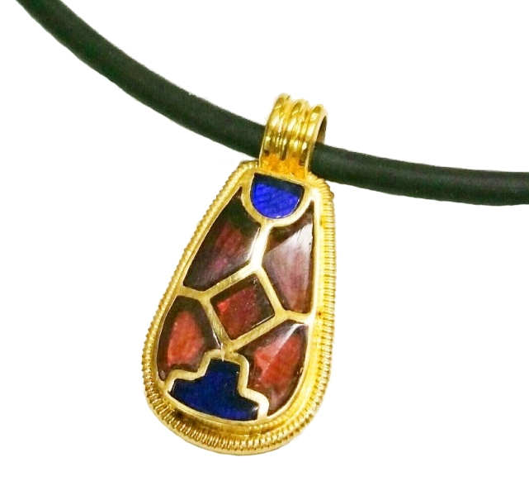
We have evidence that Vikings made jewellery, traded jewellery and stole Jewellery.
The gold and jewels came from all around the world.
Gemstones such as amethyst, amber and glass were cut and shaped to fit into gaps in gold frames.

Slide 5
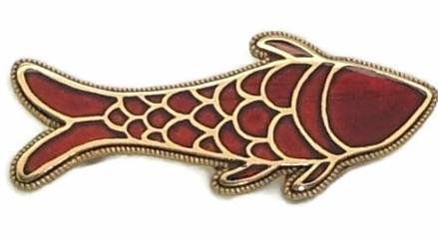
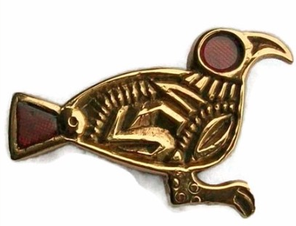
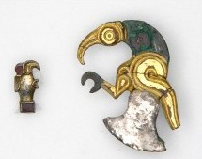
Saxon and Vikings often used animals in their designs.
Seafarers might favour fish emblems, whilst the boar and raven were associated with fighting.

Slide 6
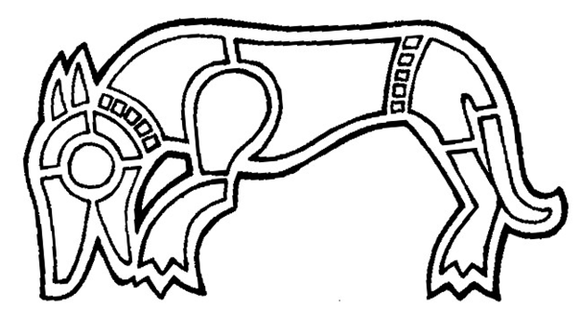
The jeweller made frames using beeswax, which were then cast using gold.
The gaps in the frame were then filled with shaped jewels.
Jewels and gold were re-used. Stolen jewels and coins from monasteries were melted down to make new objects.

Slide 7
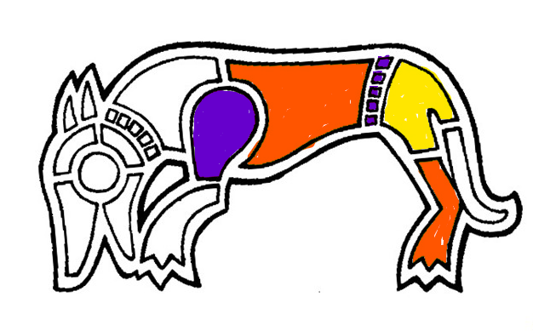
You are going to be a jeweler from the Dark Ages.
Use what you have at home to make your own version of a brooch.
Either draw your own outline, or print one off.
Using different coloured materials such as sweet wrappers or coloured paper from magazines, fill the gaps and create a brooch.
I have started colouring this boar and I have a gold pen that I could use for the outline.
Be creative if you can.
You might make a brooch from paper, card or even salt dough.
Have fun!

