Slide 1
Teacher notes
Pre-requisite reading:
Flannagan, C., Berry, D, Jarvis, M. & Liddle, R. (2015) AQA Psychology. Cheltenham: Illuminate Publishing. (p.172-173)
https://www.illuminate.digital/aqapsych1/
https://www.simplypsychology.org/experimental-method.html; https://www.simplypsychology.org/validity.html; https://www.simplypsychology.org/reliability.html
Prior Learning:
Lesson 1,2 & 3 covering experimental methods, control of variables & experimental design
WALT, Outcomes & PLC ref.:
WALT: Understand the importance of choosing the most appropriate type of experiment for psychological research. Outcomes: Describe the difference between validity and reliability; Explain different types of experimental research method; Evaluate different types of experimental research method in terms of validity and reliability. PLC ref.: AQA Paper 2 –3.2.3 (a); 3.2.3.1 (m,n)
Starter:
Complete exam questions – feedback on both correct answers & exam technique
Main Activities:
Watch the 2 videos on Reliability & Validity and complete notes in study booklet
Write notes on different types of experimental research method & strengths and limitations
Complete Apply it Concepts activity on P.172, ensuring each choice is justified appropriately
Plenary:
Choose plenary activity
Assessment:
Assessment to be carried out at each activity and appropriate feedback given
Differentiation:
Challenge activities to stretch Higher Ability students; choice of plenary activity

Slide 2
A Level Psychology Year 1 – Paper 1: Psychopathology – Depression (Clinical Characteristics)
WALT: Understand the clinical characteristics of depression and how it is diagnosed.
3) Apply knowledge of the characteristics of depression and their categorisation to scenarios
2) Explain how the DSM-5 categorises depression
1) Describe the Behavioural, Emotional and Cognitive characteristics of depression

Slide 3
Describe the Behavioural, Emotional and Cognitive characteristics of depression
Explain how the DSM-5 categorises depression
Apply knowledge of the characteristics of depression and their categorisation to scenarios
Multichoice Qs
Answer the multiple choice questions in your study booklet.
Notes:
1 = b; 2 = d; 3 = d; 4 = c; 5 = b

Slide 4
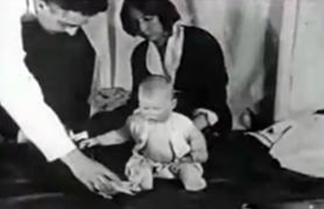
Describe the Behavioural, Emotional and Cognitive characteristics of depression
Explain how the DSM-5 categorises depression
Apply knowledge of the characteristics of depression and their categorisation to scenarios
Starter Activity - Phobias recap – Little Albert (Watson & Raynor, 1920)
Read the information on Watson & Rayner’s (1920) Little Albert study and answer the questions on p.46 of the study booklet.
Notes:
1 = b; 2 = d; 3 = d; 4 = c; 5 = b

Slide 5
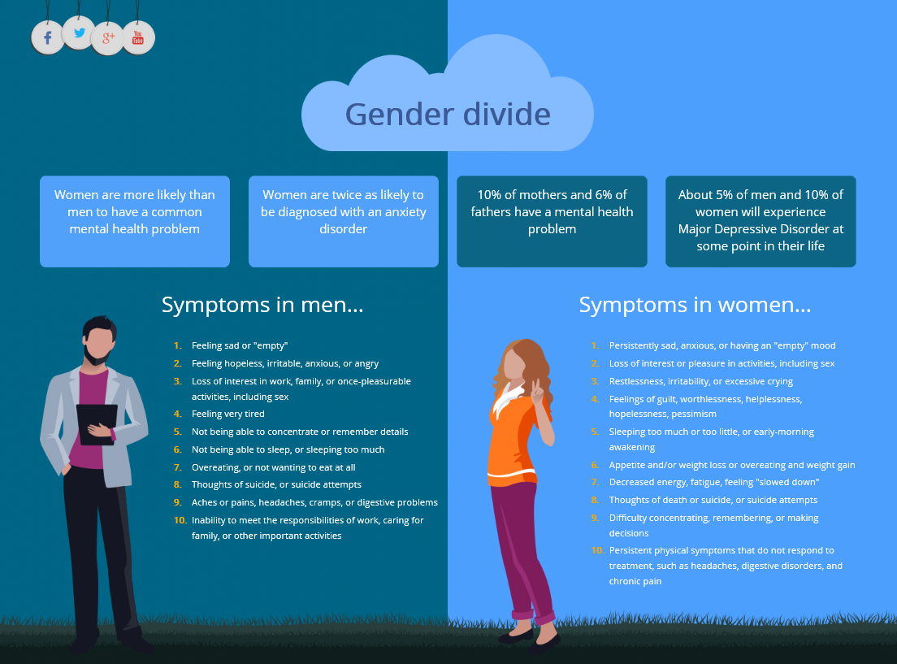
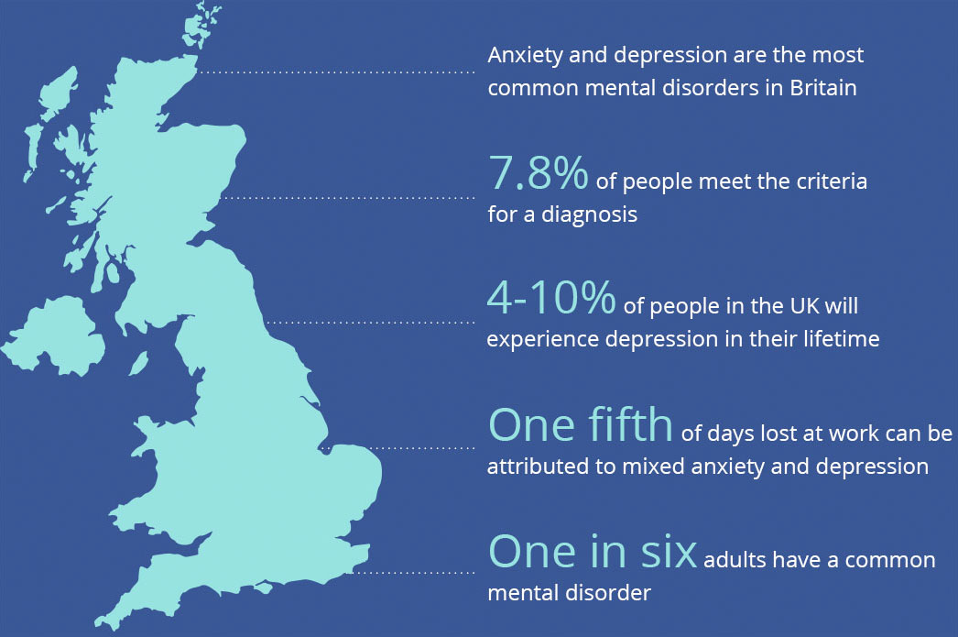
Describe the Behavioural, Emotional and Cognitive characteristics of depression
Explain how the DSM-5 categorises depression
Apply knowledge of the characteristics of depression and their categorisation to scenarios
Activity 1: Think, pair, share..
Individually, jot down any ideas what you think depression is
In pairs, discuss and add any additional ideas to your notes
Be ready to share your ideas with the rest of the class.
Definition of depression
Depression is a mood, or affective disorder. This mental Illness is a collection of physical, emotional, mental and behavioural experiences that are severe, prolonged and damaging to everyday functioning.
https://www.youtube.com/watch?v=BfZ7VKhwpeI

Slide 6
Describe the Behavioural, Emotional and Cognitive characteristics of depression
Explain how the DSM-5 categorises depression
Apply knowledge of the characteristics of depression and their categorisation to scenarios
Activity 2: Characteristics of Depression
Use p.140-141 of the textbook to annotate the diagram showing Behavioural, Emotional and Cognitive Characteristics of Depression. Your notes should include:
Key elements of each characteristic
Examples for each element
Emotional
Behavioural
Characteristics of depression
Cognitive

Slide 7
Describe the Behavioural, Emotional and Cognitive characteristics of depression
Explain how the DSM-5 categorises depression
Apply knowledge of the characteristics of depression and their categorisation to scenarios
Activity 3 – Apply It – Concepts: Jessica

Slide 8
Describe the Behavioural, Emotional and Cognitive characteristics of depression
Explain how the DSM-5 categorises depression
Apply knowledge of the characteristics of depression and their categorisation to scenarios
Activity 4 – Exam Question
Outline the characteristics of depression (Total 4 marks)
AO1 credit is awarded for an outline of the characteristics of depression. It is acceptable for candidates to cover major depressive disorder or bipolar disorder. Depression is characterised by a range of symptoms and candidates could refer to emotional, cognitive (suicidal thoughts) physical (weight loss or gain) or behavioural symptoms (decrease in sexual activity). A diagnosis of MDD can be made when five symptoms are present for at least two weeks.
To achieve top band marks at least one of two ‘core’ symptoms should be present:
• depressed mood for most of the day
• diminished interest or pleasure in activities.
Epidemiology i.e. prevalence, gender differences, prognosis etc., are creditworthy.

Slide 9
A Level Psychology Year 1 – Paper 1: Psychopathology – Depression (Clinical Characteristics)
WALT: Understand the clinical characteristics of depression and how it is diagnosed.
3) Apply knowledge of the characteristics of depression and their categorisation to scenarios
2) Explain how the DSM-5 categorises depression
1) Describe the Behavioural, Emotional and Cognitive characteristics of depression

