Slide 1
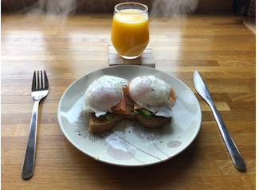
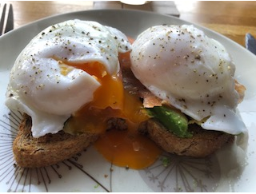
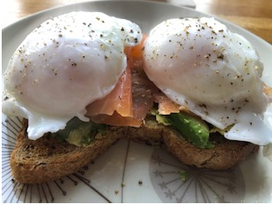
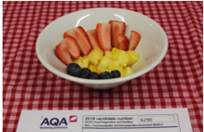
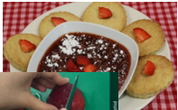
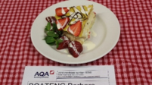
Cooking Skills Challenge 1
Plan, prepare, cook and present a range of breakfast dishes that meet the dietary needs of a teenager . Present 1 final dish for the challenge
Examples
Breakfast ideas -https://www.youtube.com/watch?v=toolz3sj9xI
1
2
Plan: Planning is important ; watch videos and write down your ingredients list . Have your method ready
Prepare: You have 2 weeks to submit your final dish . Trial 3 or 4 recipes and ask family members where possible to rate your dishes . Use their feedback to improve your trial dishes
TDA Staff
Mrs Roberts
3
4
Cook – After choosing your best dish , use all the feedback you got and prepare the final dish. You should aim to demonstrate skills in all aspects of the preparation and presentation of the dish
Present– Present 1 final dish on SMHW for assessment
For authenticity you should label the dish with your name
TDA Students

