Slide 1
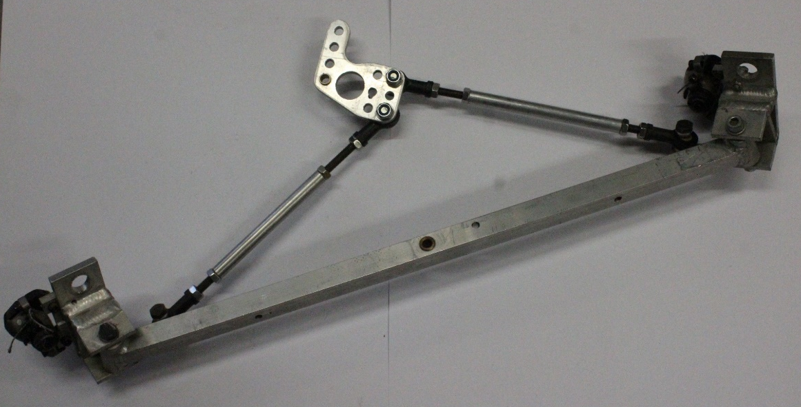
Thomas Deacon Academy Green power
Team 2010

Slide 2
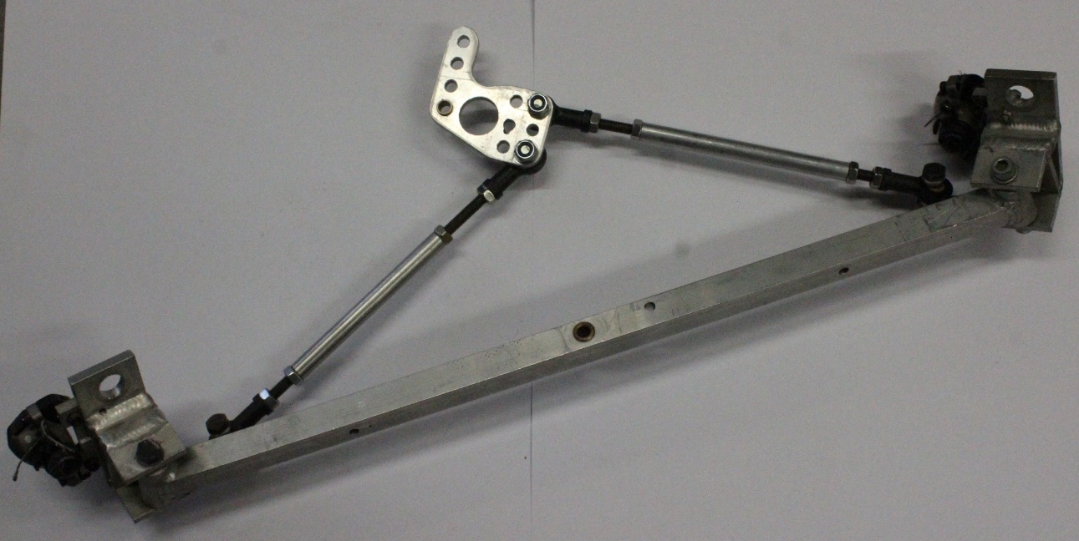
1

Slide 3
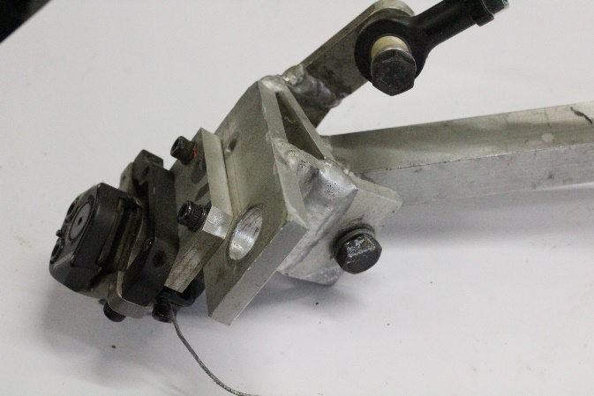
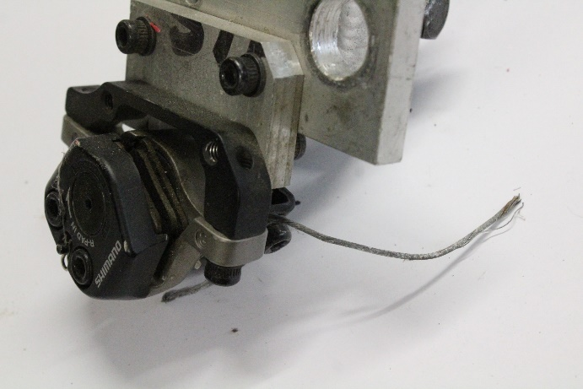
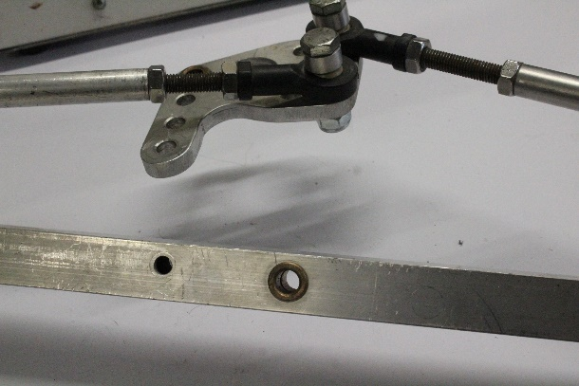
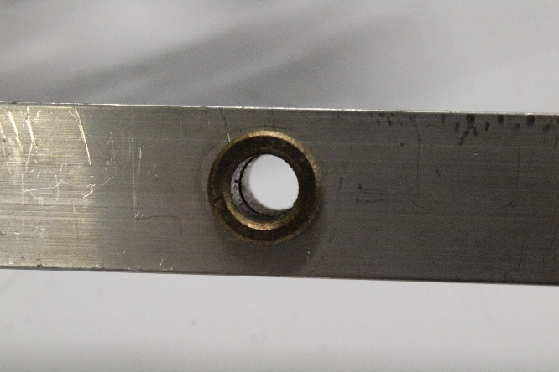
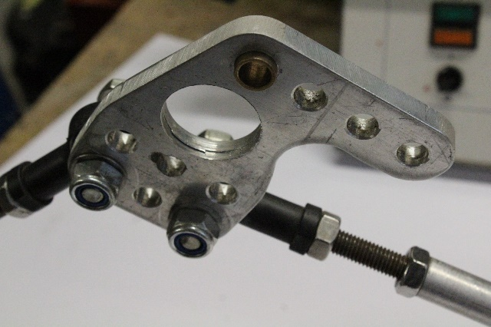
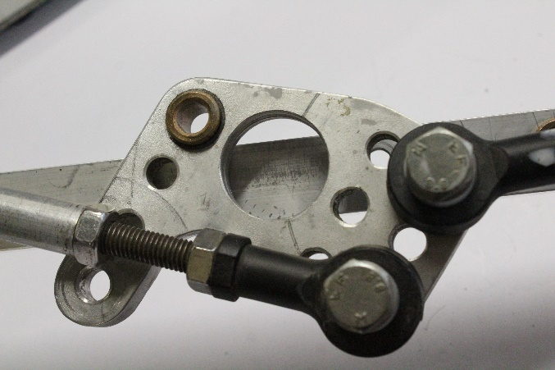

Slide 4
Greenpower Car
Part | Name
1 | Support bracket | Aluminum alloy | Cut, milled, drilled
2 | Piston rod | Steel alloy | Extruded cut and dip coated
3 | Rod end | Steel alloy | Die cast then machined
4 | Main axle support bar | Aluminum alloy | Extruded and cut
5 | Bush | Brass | Turned
6 | Support bracket- wheel | Aluminum alloy | Cut, milled, drilled and welded
7 | Brake caliper | HDPE | Injection molded
8 | Locking nuts | Steel alloy and PET | Batch produced and machined
9 | Nuts | Steel alloy | Batch produced and machined
10 | Wheel | Aluminum alloy which is dip coated , spokes are galvanised steel
11 | Wheel plate | Stainless steel | Stamped
12 | Hex head bolts | Medium carbon steel | Batch produced and machined
13 | Spring washer | Steel alloy | Stamped and press formed
14 | Counter sink bolts | Medium carbon steel | Batch produced and machined
15 | Bearing | Steel alloy | Batch produced and machined

Slide 5
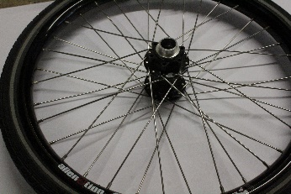
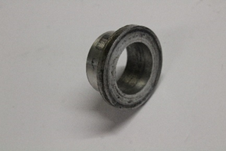
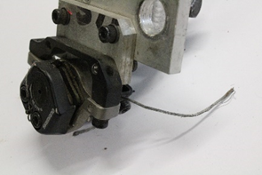
 | Description – Size and Colour |  | Size and mass (g) | Use
1– Wheel Tyre | Black and silver, the tyre is a circle shape and has treads on it. The wheel has spokes on it |  | The diameter is 360 mm and it has a mass of 50 kg | The wheel helps steer and move the Green power car , and moves it forward. They consist of a tread and a body. The tread provides traction while the body provides containment for a quantity of compressed air. Before rubber was developed, the first versions of tires were simply bands of metal fitted around wooden wheels to prevent wear and tear.
Material : The rim is Stainless steel. | Properties of the material – How is this connected to its use. Stainless steel contains iron, chromium, manganese, silicon and carbon. Stainless steel is very resistant to corrosion but using electroless nickel plating as an alternative to stainless steel has many advantages. |  |  | Manufacturing Method – The first step in the tire manufacturing process is the mixing of raw materials—rubber, carbon black, sulphur, and other materials—to form the rubber compound. ... When a green tire is finished, the metal drum collapses, allowing the tire assembler to remove the tire. The green tire is then taken to a mould for curing.
2-bearing | Black but inner circle is silver | 25 mm |  | a bearing is a device that is used to enable rotational or linear movement, while reducing friction and handling stress. Resembling wheels, bearings literally enable devices to roll, which reduces the friction between the surface of the bearing and the surface it's rolling over.
Material: steel | Properties of the material – How is this connected to its use = steel contains iron, chromium, manganese, silicon and carbon. Steel is very strong but heavy |  |  | Manufacturing Method – The Centre Lathe is used to manufacture cylindrical shapes from a range of materials including; steels and plastics. Many of the components that go together to make an engine work have been manufactured using lathes. These may be lathes operated directly by people or computer controlled lathes that have been programmed to carry out a particular task. A basic manual centre lathe is shown below. This type of lathe is controlled by a person turning the various handles on the top slide and cross slide in order to make a product part.
3-brake calliper and support bracket | The brake calliper is black and the support bracket is silver. | 90mm |  | A calliper is part of the disc brake system. When you press the brake pedal, the brake fluid flows from the master cylinder to the callipers. Brake fluid then applies pressure on the piston inside the calliper, pushing the brake pads against the rotors to slow/stop your car.
Materials: plastic- polyethylene | Properties of the material – How is this connected to its use- its black and It is rugged, flexible, and durable. It has outstanding chemical and environmental stress crack resistance. |  |  | Manufacturing Method – Injection moulding is the process of injecting the material into a mould making the process cleaner and simple to do, it is usually done with plastics since they are easy to heat up and to melt. This is done by spinning a screw there for moving the material forward into the mould and filling any gaps of air with plastic due to the constant pushing of the material.

Slide 6
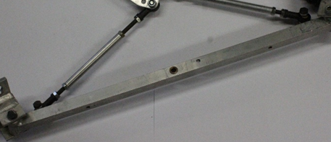
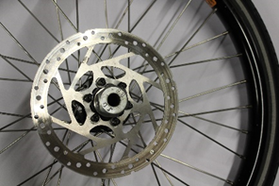
4-hex head bolts | Black and silver and has an adjustable triangular shape. |  | 840mm | Bolts use a wide variety of head designs, as do screws. These are designed to engage with the tool used to tighten them. Some bolt heads instead lock the bolt in place, so that it does not move and a tool is only needed for the nut end. Common bolt heads include hex, slotted hex washer, and socket cap.
Materials: medium carbon steel | Properties of the material – good formability and weld ability, low strength, low cost. good toughness and ductility, relatively good strength, may be hardened by quenching. high strength, hardness and wear resistance, moderate ductility. |  |  | Manufacturing Method – The larger version of the machine drill is called the pillar drill. This has a long column which stands on the floor. This can do exactly the same work as the bench drill but because of its larger size it is capable of being used to drill larger pieces of materials and produce larger holes. Andi its been cut by a saw which is a tool consisting of a tough blade, wire, or chain with a hard toothed edge. It is used to cut through material, very often wood though sometimes metal or stone.
5 Rod end | Silver all around but the bolt has a black rim. | 80mm |  | Such joints are used on the ends of control rods, steering links, tie rods, or anywhere a precision articulating joint is required, and where a clevis end is unsuitable
Materials: steel alloy | Properties of the material – How is this connected to its use = the colour is silver and it has holes in it so you can screw into it. Light Weight. Corrosion Resistance. Electrical and Thermal Conductivity. Reflectivity. |  |  | Manufacturing Method – A vertical miller is used to shape metals such as mild steel and aluminium. It can also be used to shape plastics such as perspex and nylon. Full size milling machines such as the one shown below are powerful but also very accurate/precise. The cutting tools are very expensive and are broken easily if the machine operator tries to take too deep a cut, in one go. When using a vertical miller, the machine should be set up to cut away only a small amount of metal each time the cutter passes over the surface of the metal. And its been filed and pillar drilled for the holes and edges.
6-wheel plate | The plate is silver with a shiny finish |  | 160mm | A nave plate is a large hubcap in the form of a plate which covers the entire wheel. to make them appear modern and streamlined, and to make it easier to keep them clean.
Materials: stainless steel | Properties of the material – Stainless steel contains iron, chromium, manganese, silicon and carbon. Stainless steel is very resistant to corrosion but using electro less nickel plating as an alternative to stainless steel has many advantages. |  |  | Manufacturing Method– it has been stamped which is a thin piece of metal which is stamped and it cuts it out. Then it was drawn which is when they pull a piece of metal and it gets thinner

Slide 7
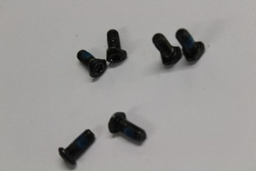
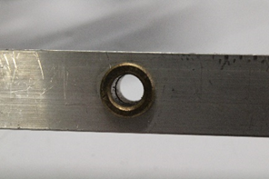
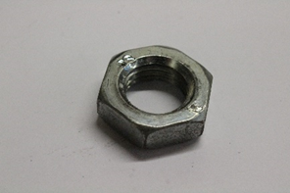
7-counter sink bolt | All black | 15mm | A common use is to allow the head of a countersunk bolt, screw or rivet, when placed in the hole, to sit flush with or below the surface of the surrounding material
Materials: zinc plated steel | Properties of the material – How is this connected to its use-Stainless steel contains iron, chromium, manganese, silicon and carbon. Stainless steel is very resistant to corrosion but using electroless nickel plating as an alternative to stainless steel has many advantages. |  | Manufacturing Method – batch = Shearing, also known as die cutting, is a process which cuts stock without the formation of chips or the use of burning or melting. Strictly speaking, if the cutting blades are straight the process is called shearing; if the cutting blades are curved then they are shearing-type operations.
8-bush | Gold coated in a silver rod | 15mm | A bush is a mechanical fixing between two, possibly moving, parts, or a strengthened fixing point where one mechanical assembly is attached to another. In a car or other vehicle's suspension, bushes are used to connect the various moving arms and pivot points to the chassis and other parts of the suspension.
Material: brass | Properties of the material – How is this connected to its use = contains iron, chromium, manganese, silicon and carbon. Stainless steel is very resistant to corrosion but using electroless nickel plating as an alternative to stainless steel has many advantages. |  | Manufacturing Method - The larger version of the machine drill is called the pillar drill. This has a long column which stands on the floor. This can do exactly the same work as the bench drill but because of its larger size it is capable of being used to drill larger pieces of materials and produce larger holes.
9-nuts | Silver all around | 35mm | So you can screw it into the tire so it doesn’t come off while you are riding it.
Materials: zinc plated steel | Properties of the material – How is this connected to its use-Stainless steel contains iron, chromium, manganese, silicon and carbon. Stainless steel is very resistant to corrosion but using electroless nickel plating as an alternative to stainless steel has many advantages. |  | Manufacturing Method – batch = A vertical miller is used to shape metals such as mild steel and aluminium. It can also be used to shape plastics such as perspex and nylon. Full size milling machines such as the one shown below are powerful but also very accurate/precise. The cutting tools are very expensive and are broken easily if the machine operator tries to take too deep a cut, in one go. When using a vertical miller, the machine should be set up to cut away only a small amount of metal each time the cutter passes over the surface of the metal.

Slide 8
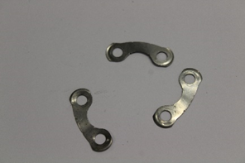
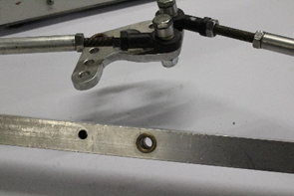
10-spring washers | Silver all around but black bolts go through | 32mm | Spring washers, which have axial flexibility and are used to prevent fastening or loosening due to vibrations. Locking washers, which prevent fastening or loosening by preventing unscrewing rotation of the fastening device; locking washers are usually also spring washers.
Materials: steel alloy | Properties of the material – How is this connected to its use steel contains iron, chromium, manganese, silicon and carbon. Steel is very strong but heavy |  | Manufacturing Method – batch = A vertical miller is that it can be used to shape plastics such as perspex and nylon. Full size milling machines such as the one shown below are powerful but also very accurate/precise. The cutting tools are very expensive and are broken easily if the machine operator tries to take too deep a cut, in one go. When using a vertical miller, the machine should be set up to cut away only a small amount of metal each time the cutter passes over the surface of the metal. And then it was pillar drilled to make the halls.
11-support bracket | Silver with gold and black features | 690mm | Uses. Brackets can support many architectural items, including a wall, balcony, parapets, eaves, the spring of an arch, beams, pergola roof, window box, or a shelf. The term is also used to describe a shelf designed to hold a statue.
Materials: aluminium alloy | Properties of the material – How is this connected to its use = steel contains iron, chromium, manganese, silicon and carbon. Steel is very strong but heavy |  | The manufacturing method use is a machine drill is called the pillar drill. This has a long column which stands on the floor. This can do exactly the same work as the bench drill but because of its larger size it is capable of being used to drill larger pieces of materials and produce larger holes.
12-locking nuts | All silver but black and gold holes for rivets | 130mm | locknut, also known as a lock nut, locking nut, prevailing torque nut, stiff nut or elastic stop nut, is a nut that resists loosening under vibrations and torque. Elastic stop nuts and prevailing torque nuts are of the particular type where some portion of the nut deforms elastically to provide a locking action
Materials: steel alloy | Properties of the material – How is this connected to its use = The main advantage of aluminium is that it has low density, highly inert to oxygen and malleable |  | Milling is a cutting process that uses a milling cutter to remove material from the surface of a work piece. Drilling is a cutting process that uses a drill bit to cut a hole of circular cross-section in solid materials.

Slide 9
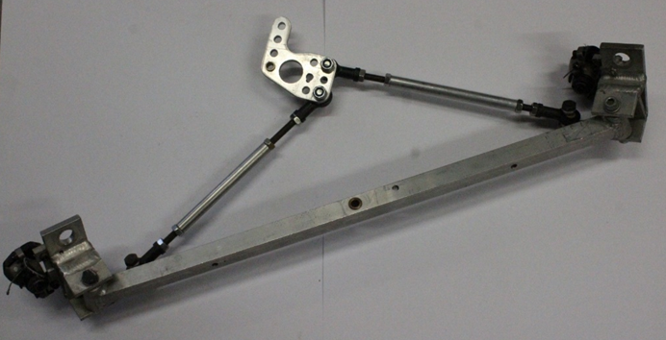
14-main axle support bar | The edges are black and the rest is silver | 870mm | Vehicle axles. Axles are an integral component of most practical wheeled vehicles. In a live-axle suspension system, the axles serve to transmit driving torque to the wheel, as well as to maintain the position of the wheels relative to each other and to the vehicle body.
materials: aluminum | The main advantage of aluminium is that it has low density, highly inert to oxygen and malleable Light Weight. Corrosion Resistance. Electrical and Thermal Conductivity. Reflectivity. |  | Manufacturing Method – Mass, Batch or One-Off Milling is a cutting process that uses a milling cutter to remove material from the surface of a work piece. Drilling is a cutting process that uses a drill bit to cut a hole of circular cross-section in solid materials Then assembled.

Slide 10
Product Specification
Product use and function | It helps the wheel to steer around and so that the steering wheel controls the wheels
Legal and ethical considerations. | A scrutineer will check the car over to ensure it is safe to compete. The Green power scrutineering process checks that all elements of your car are safe and that the kit has been built according to the regulations.
Operation and performance | So I would need to steer the steering wheel and so this would transfer the wheels to move around
Physical dimensions | The vehicle must not exceed 1200 mm in width, ground clearance must not be less than 30 mm. No part of the vehicle may extend more than 800 mm behind the centre point of the rear wheels.
Production quantities | We are making one unless there are more additional members in the team so that we could make more
Product life | There are three events during the year plus the race day so the product needs to last for a minimum of 1 year and be able to be used without any parts being replaced at all of these events.
Reliability | The Green power car must compete in two 90 minutes races per event. A minimum of three drivers must be used during each race. The winner is the car that goes the furthest distance in 90 minutes.
Power requirements | All wires and terminals on the vehicle must be neatly run, secured and unable to chafe, away from moving parts.
Safety issues | You need to assure that the brakes are fitted on correctly so you don’t lose control
Parts selection | The preferred brand for the brake calliper is ?

Slide 11
Product Specification
Requirements for styling/aesthetics | It must be presentable for Thomas deacon academy
Ergonomic considerations | It has to be designed for an average 16-25 year old and so it can hold the persons weight.
Materials | It has to be strong but light and so it can hold a person and so it can go quick around the track.
Manufacturing constraints | We only have some machines which are pillar drills, milling machine, welder.
Maintenance requirements | The maintenance requirements need to be simple enough so the school can build it.
Environmental considerations | It has to be recyclable and the vehicle is electric so it is not using fuel

