Slide 1
Assessment criteria
A level PD

Slide 2
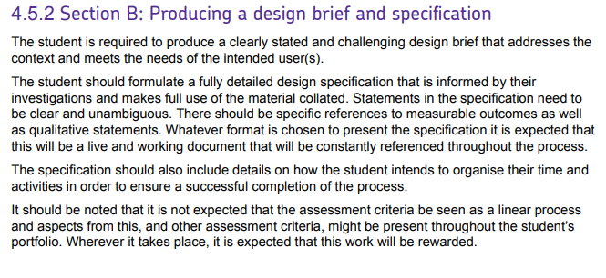

Slide 3
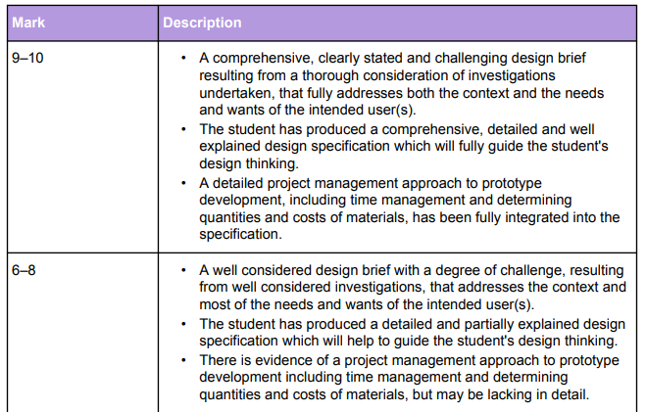

Slide 4
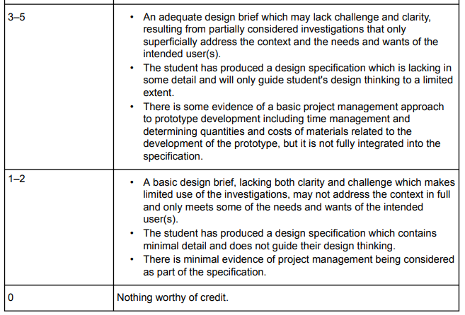

Slide 5
Initial and further specification examples

Slide 8
Example 3

Slide 10
Example 4

Slide 11
