Slide 1
3.1.1 Corporate objectives | Development of corporate objectives from mission statement/corporate aims Critical appraisal of mission statements/corporate aims
3.1.2 Theories of corporate strategy | Development of corporate strategy: o Ansoff’s Matrix o Porter’s Strategic Matrix Aim of portfolio analysis Achieving competitive advantage through distinctive capabilities Effect of strategic and tactical decisions on human, physical, and financial resources
3.1.3 SWOT analysis | a) SWOT analysis o internal considerations: strengths and weaknesses o external considerations: opportunities and threats
3.1.4 Impact of external influences | PESTLE (political, economic, social, technological, legal and environmental) The changing competitive environment Porter’s Five Forces

Slide 2
Guidance From Edexcel

Slide 3
By the end of this powerpoint you should be able to
To be able to discuss the Development of corporate objectives from mission statement/corporate aims
To be able to make a critical appraisal of mission statements/corporate aims
To be able to answer sample exam questions based on the topic area

Slide 4
Mission statement:
To inspire and nurture the human spirit – one person, one cup and one neighbourhood at a time.
Which business do you think this might be from?

Slide 5
Answer to starter

Slide 6
Development of corporate objectives from mission statement/corporate aims

Slide 7
Mission statements
A mission statement is a short way of a business expressing their main intent
Nike’s mission statement is "To bring inspiration and innovation to every athlete* in the world.“
The legendary University of Oregon track and field coach, and Nike co-founder, Bill Bowerman said, "If you have a body, you are an athlete."
The Coca Cola Company Mission
Our mission is:
To refresh the world in mind, body and spirit
To inspire moments of optimism and happiness through our brands and actions
To create value and make a difference.
See website here

Slide 8
Mission statements
"The mission of The Walt Disney Company is to be one of the world's leading producers and providers of entertainment and information. Using our portfolio of brands to differentiate our content, services and consumer products, we seek to develop the most creative, innovative and profitable entertainment experiences and related products in the world."
A mission statement sets out the purpose and primary objectives of a business in the present.
A mission statement should be memorable
A mission statement should be inspiring
A corporate vision looks towards the future and where the business would like to be

Slide 9
What does it mean to “exceed customer expectations”?

Slide 10
Corporate objectives
Corporate objectives should flow from the mission statement and corporate vision
Usually set by senior management for the whole company
Aimed at satisfying the shareholders so may be related to profit or dividends:
Increase operating profit 4% over the next 24 months
Increase dividends by 2% over the next three years

Slide 11
Department functional objectives
In most businesses they divide up the work into departments or functions; sales, marketing, human resources, operations and finance
Each department will set their own objectives which should flow from the corporate objectives
For example the marketing department may aim to increase sales 3% each quarter, or increase sales revenue 2% each year
This will help the business to achieve its corporate objectives of more dividends for the shareholders

Slide 12
SMART objectives (Companies try and make their department objectives SMART)
Specific; This means there must be a clear definition, often including a number
Measurable; This means the achievement can be checked
Achievable; This means you can achieve your target but you may need to stretch yourself
Realistic; This means that the target should sensible so that you can achieve it
Time-related; this means setting a date for achievement or review
To achieve a 30% share of the total sales in the children’s clothing market within five years

Slide 13
Critical appraisal of mission statements/corporate aims

Slide 14
Example of mission statement
What is the purpose of this mission statement?
O2VISION
To establish a global knowledge sharing network that will change the world of communications forever.
O2MISSION
To establish the O2 World Academy to make the practice of innovation available for everyone
To establish the O2 Café to house the academy and provide the world with an inspiring creative environment
To promote talent, hiring fresh minded people with a bright creative flair to be nurtured and developed
To develop creative communications strategies based on an extensive understanding of the consumer through our concept ‘know your market first”
To lead our clients and partners in the market by reaching collaborative, researched solutions that work, creating instant recognition and a compelling call for action
To put the consumer at the heart of our strategies, creating consumer based concepts that push the limits of traditional communications
To provide our team members a positive and inspiring creative environment, a place where they enjoy being, where they feel fulfilled, that encourages professional development and gives rise to creative ingenuity
To establish a multidisciplinary communications network and to be the first network to grow globally from the GCC
Who is the intended audience?

Slide 15
Example of mission statement
What is the purpose of this mission statement?
Our vision
Most respected and admired company.
Our mission
We deliver outstanding automotive products and services to our customers, and enrich our community, partners and environment.
Our four core values
Customer first
Respect for people
International focus
Continuous improvement and innovation.
Who is the intended audience?

Slide 16
Uses of mission statements
Focus; Internally, having a mission statement can create a high level of focus and involvement from those within the organisation whilst assisting in the reinforcement of direction in which the organisation will take.
Identity; Externally it can create a sense of identity for the organisation and it can help in establishing the position in the marketplace the organisation will fit.
Profitability; Having strong corporate values which are reflected in the mission statement, this will create profitability and employees will become more motivated and more efficient, as they are aware that what they are doing in their job has a more significant purpose beyond just the general task or duty.*
Notes:
* Extract from http://www.ehow.co.uk/info_12282213_advantages-disadvantages-using-mission-statements.html

Slide 17
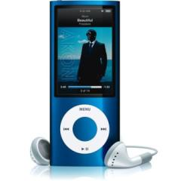
Limitations of mission statements
Can be unrealistic and over optimistic
Can be a waste of management time and resources, like all planning and followed
Can lead to conflicts and inconsistencies when not properly written
Can be ambiguous
Can become obsolete as the business develops but the mission statement remains the same (perhaps due to a merger or change of product, ipod to iphone for example)

Slide 18
CRITICALLY APPRAISE ONE OF THESE MISSION STATEMENTS
Choose the 02, Toyota one or another one

Slide 19
If you would like to complete some practice questions on Corporate objectives
Please work through these
Sample questions

Slide 20
Sample question 1
2 marks
No context required

Slide 21
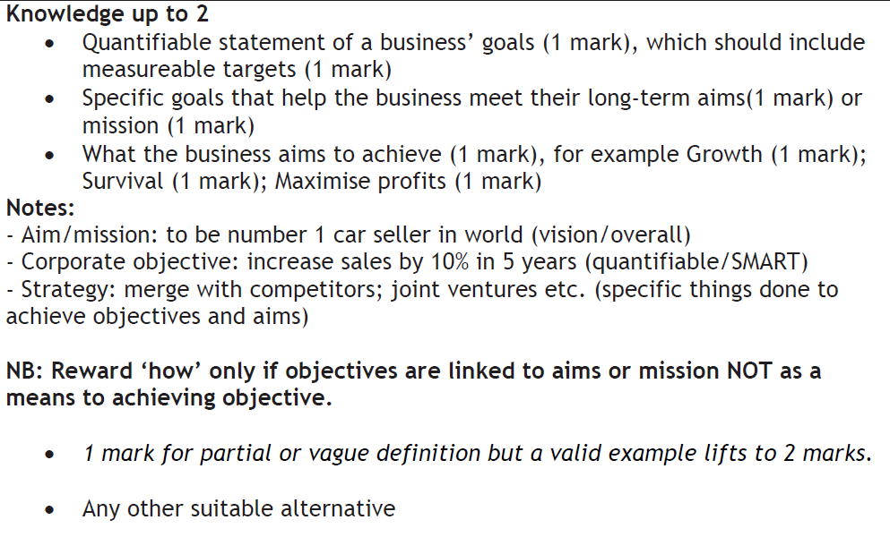
Answer question 1

Slide 23
slides hidden for use in assessment

Slide 24
Sample question 2
6 marks
Case study on next 2 slides
Guiding principles are Toyota’s version of a mission statement (just because its not called a fish doesn’t mean its not a fish)

Slide 25
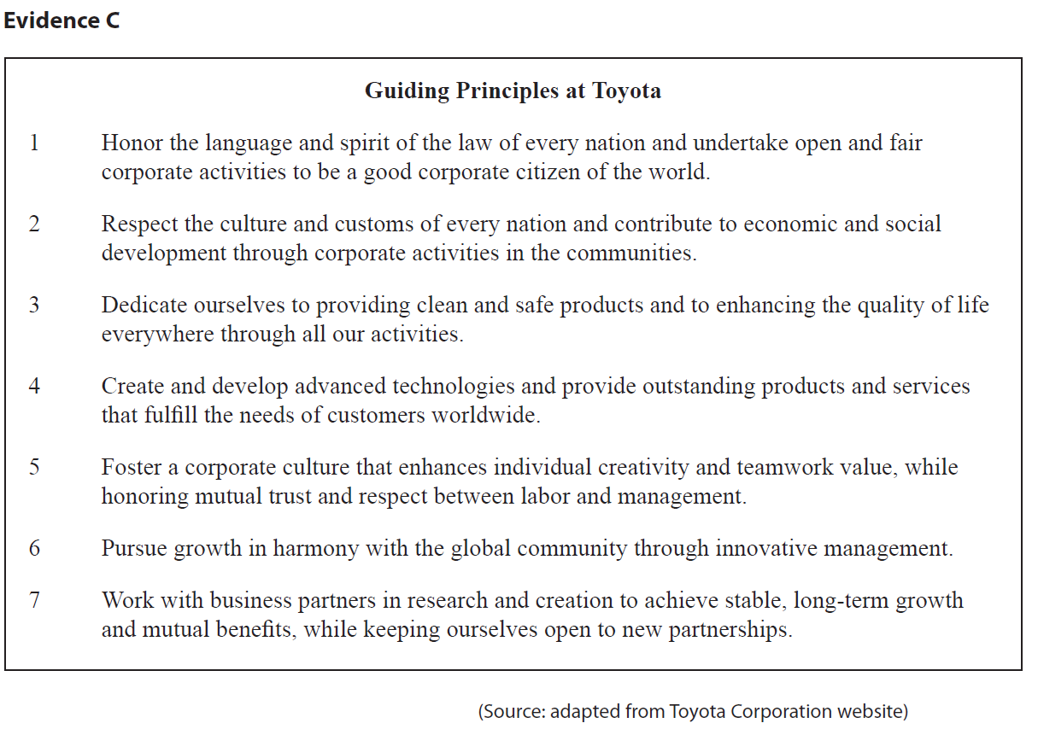

Slide 26
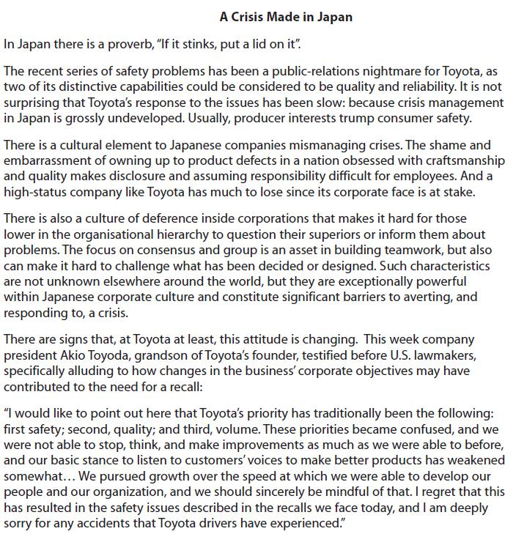

Slide 27
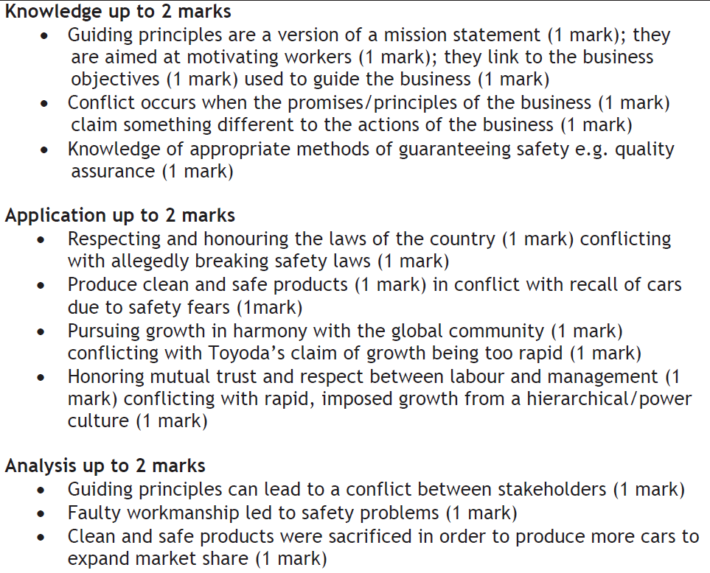
Answer question 2

Slide 28
Revision Video

Slide 29
Glossary
Mission statement; Defines the fundamental purpose of an organisation or enterprise, briefly describing why it exists and what it does to achieve its vision.
Corporate vision; outlines what the organisation wants to be, or how it wants the world in which it operates to be.*
Functional objective; a departmental objective which helps the business to achieve its mission
Notes:
Taken from : http://steinvox.com/blog/tip-for-2013-time-to-review-vision-and-mission-statements/

