Slide 1
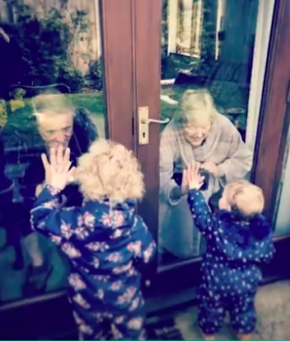
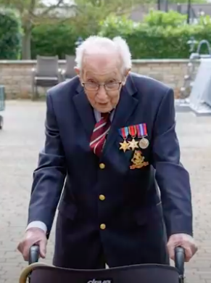
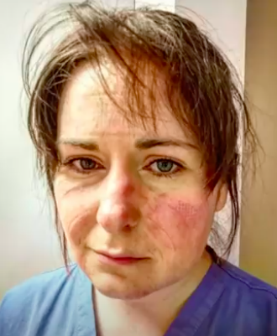
The Duchess of Cambridge has launched Hold Still. A community photography project to reflect life during Coronavirus; highlighting the resilience, kindness, and bravery of the nation.
There are three themes to explore:
Helpers and Heroes
Your New Normal
Acts of Kindness
TDA’s Photography Dept welcome submissions from TDA and TDAJ pupils, their families and teachers. All entries will be showcased in an exhibition at TDA on returning to school.
Send all exhibition entries to oxt@tda.education with your full name, year group and the category by 18th July 2020.
For more information and to submit entries to Hold Still go to:
https://www.npg.org.uk/hold-still/
“Even if we are alone, we can all create something together”

